Slide 1
Follow the 3Rs of Explosives Safety
Munitions
Are
Dangerous
Notes:
Notes:
Explain: The purposes of this presentation is to:
State the 3Rs of Explosives Safety and their meaning
Learn how to recognize hazards associated with munitions, including unexploded ordnance or UXO at your installation
Understand the reason munitions, particularly UXO, are dangerous
Stress the importance of the 3Rs of Explosives Safety:
Recognize – when you see a munition and that it is dangerous
Retreat – do not touch it, but carefully leave the area
Report – call local authorities to report what you saw
Advise audience they must:
Be aware of the dangers munitions pose
Know the actions to take to protect themselves, their families, friends and communities

Slide 2
Munitions are designed to be dangerous
Munitions are designed to be dangerous. Our nation’s military have used and continue to use land and water across the United States for live-fire training or testing with munitions. As a result, munitions that are unexploded ordnance (UXO) may be present on both land and in the water. No matter what you call munitions — ammo, explosives, unexploded ordnance or UXO, duds, souvenirs — remember munitions are dangerous and can explode if you touch, move or disturb them.
Munitions may be encountered anywhere past or present military training occurred.
Personnel also have been injured or killed from munitions.
Should you encounter a munition – follow the 3Rs

Slide 3
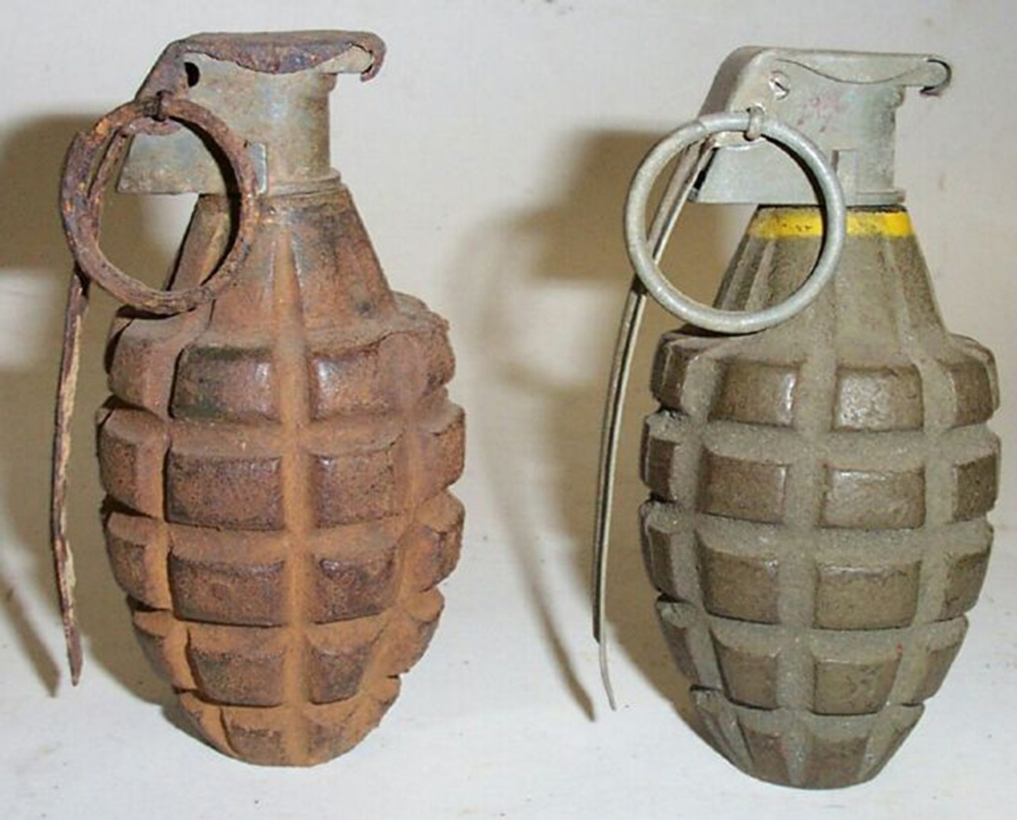
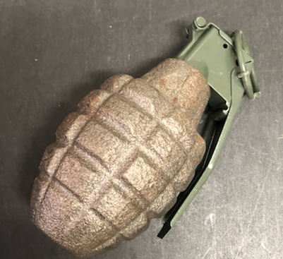
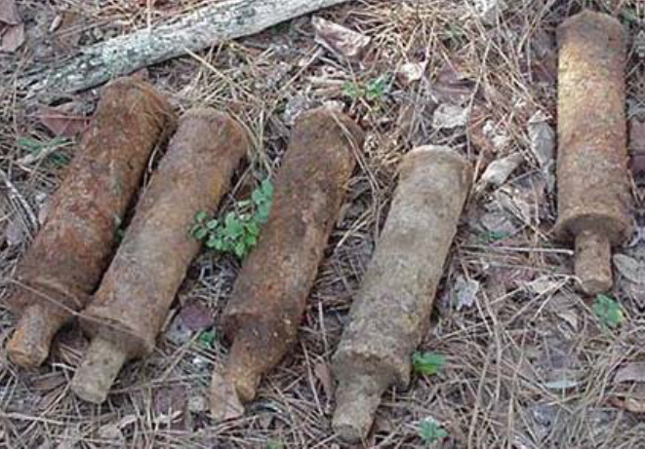
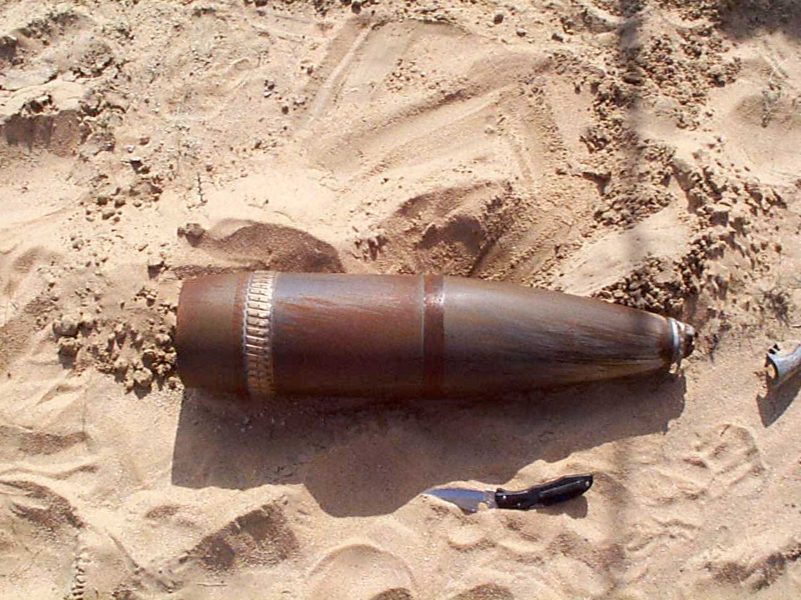
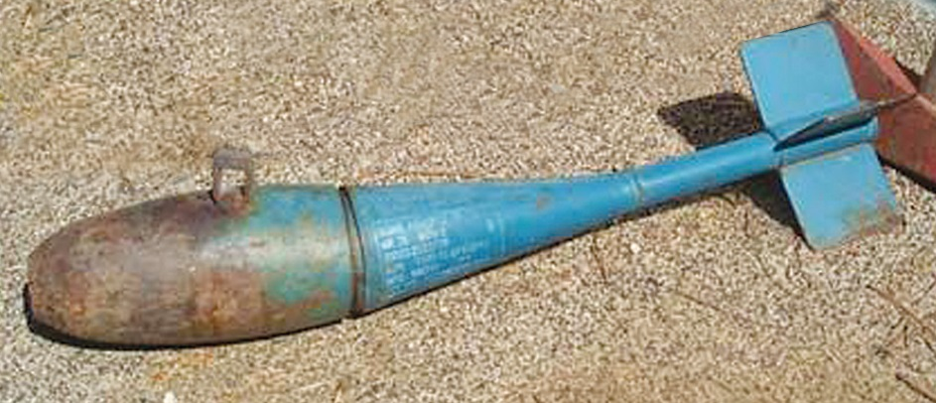
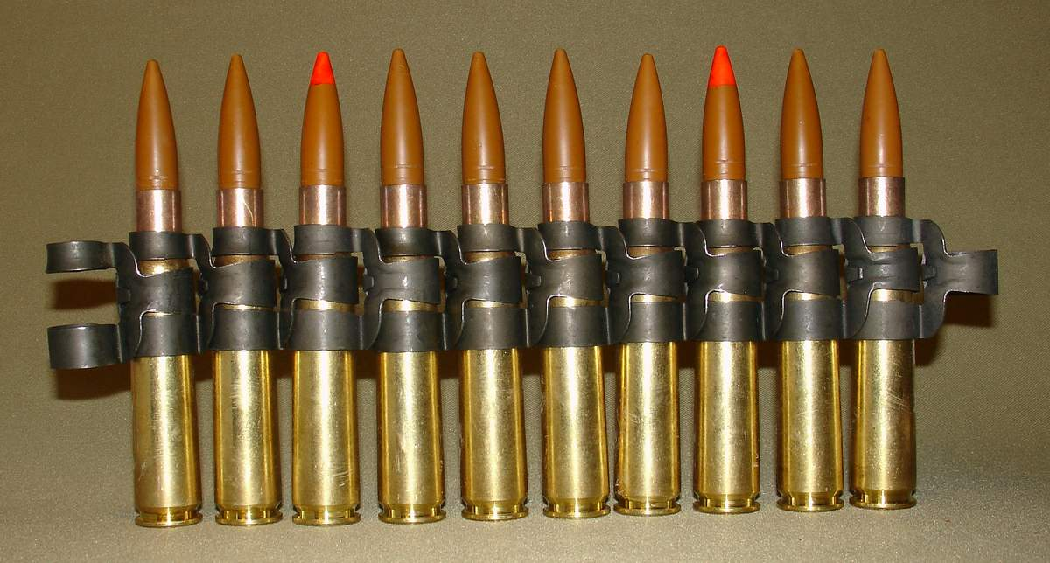
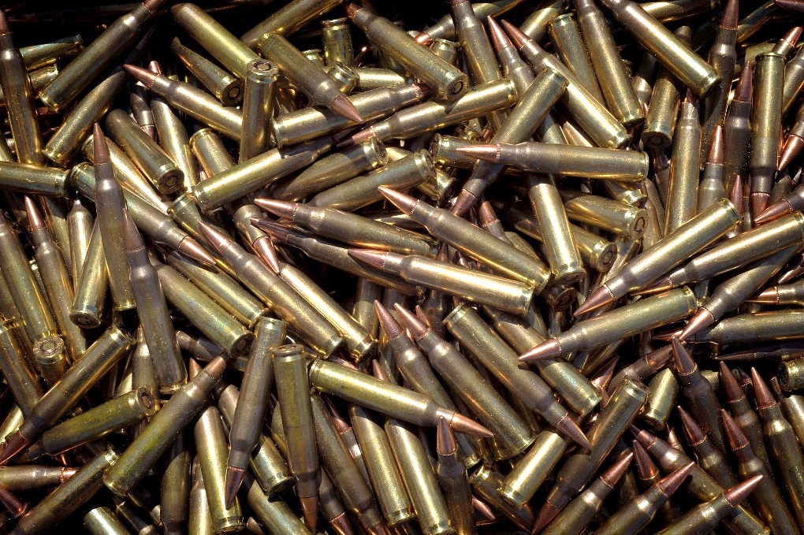
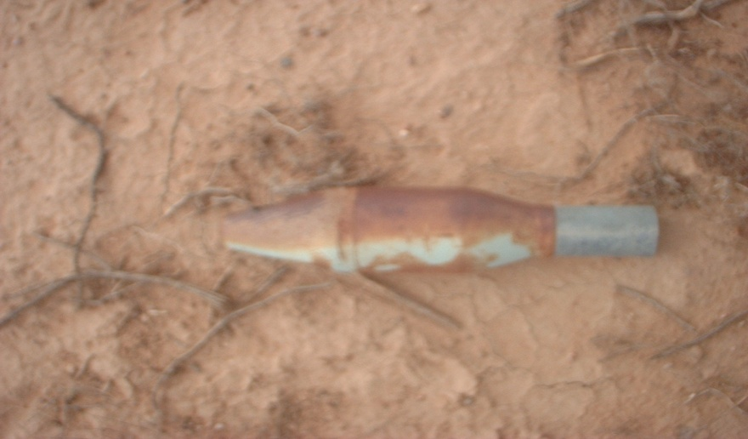
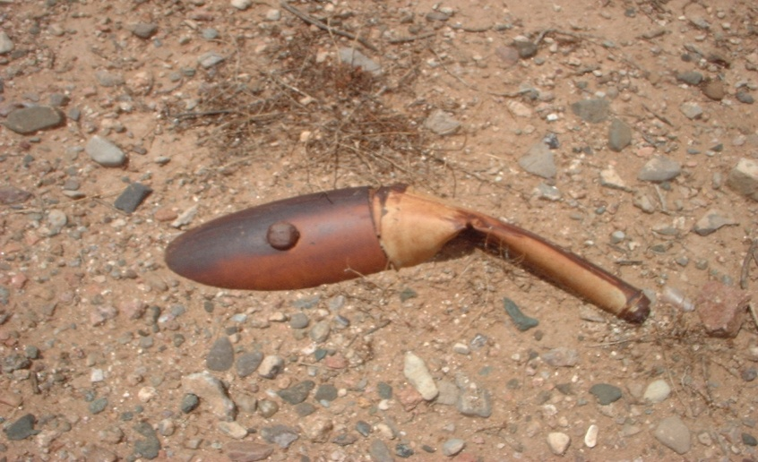
What Are Munitions?
Munitions include:
Grenades
Artillery
& Mortar Rounds
Bombs
Small Arms Ammunition
Notes:
Notes:
Explain:
For the purposes of this presentation, munitions are military weapons, ammunition, or supplies.
The term military munitions is interchangeable with ammunition (ammo), explosives and ordnance.
Most munitions are designed to kill or injure people or damage equipment and buildings. Even practice and training munitions may contain a small propellant or explosive charge that can be dangerous.
Munitions come in many sizes and shapes. They can be:
Small, like the small arms ammunition (.50 caliber and below) used in personal weapons (e.g., pistols, rifles);
Small, medium or large projectiles that are fired from mortars, tanks, or artillery pieces;
Bombs dropped from aircraft; or
Missiles, rockets or torpedoes.
Ask: What are some other examples of munitions with which you are familiar?
Answer: Possible answers include grenades, mines, rockets, mortars, RPGs, cannon balls and torpedoes. Discussion of booby traps and pyrotechnics can also be provided here.

Slide 4
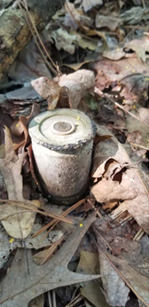
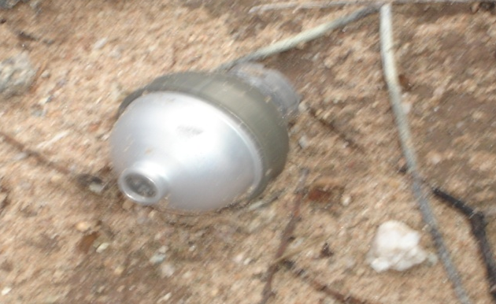
What Is UXO?
What is Unexploded Ordnance?
As defined in 10 U.S.C. 101(e)(5)(A) through (C), the term “unexploded ordnance” means military munitions that:
(A) Have been primed, fused, armed, or otherwise prepared for action;
(B) Have been fired, dropped, launched, projected, or placed in such a manner as to constitute a hazard to operations, installations, personnel, or material; and
(C) Remain unexploded, whether by malfunction, design, or any other cause.
Notes:
Notes:
Explain: UXO stands for Unexploded Ordnance. What is unexploded ordnance?
As defined in 10 U.S.C. 101(e)(5)(A) through (C), the term “unexploded ordnance” means military munitions that:
Have been primed, fused, armed, or otherwise prepared for action;
Have been fired, dropped, launched, projected, or placed in such a manner as to constitute a hazard to operations, installations, personnel, or material; and
Remain unexploded, whether by malfunction, design, or any other cause.
Discuss: 3Rs Fact Sheet – UXO Safety
Play: 3Rs Video – Learn the 3Rs of UXO (3:31 minutes) https://www.youtube.com/watch?v=bJKmlNzglHc&list=PLeSiLkpEC_PSxhu8tTv5IF0vnV4qhOjNA&index=2
or
3Rs Video – USACE – Message A (1:01 minutes) https://www.youtube.com/watch?v=WnJ-kIXhfIo&list=PLeSiLkpEC_PSxhu8tTv5IF0vnV4qhOjNA&index=7
or
3Rs Video – USACE – Message B (Beach) (1:01 minutes) https://www.youtube.com/watch?v=x4vvG-R8DIM&list=PLeSiLkpEC_PSxhu8tTv5IF0vnV4qhOjNA&index=10

Slide 5
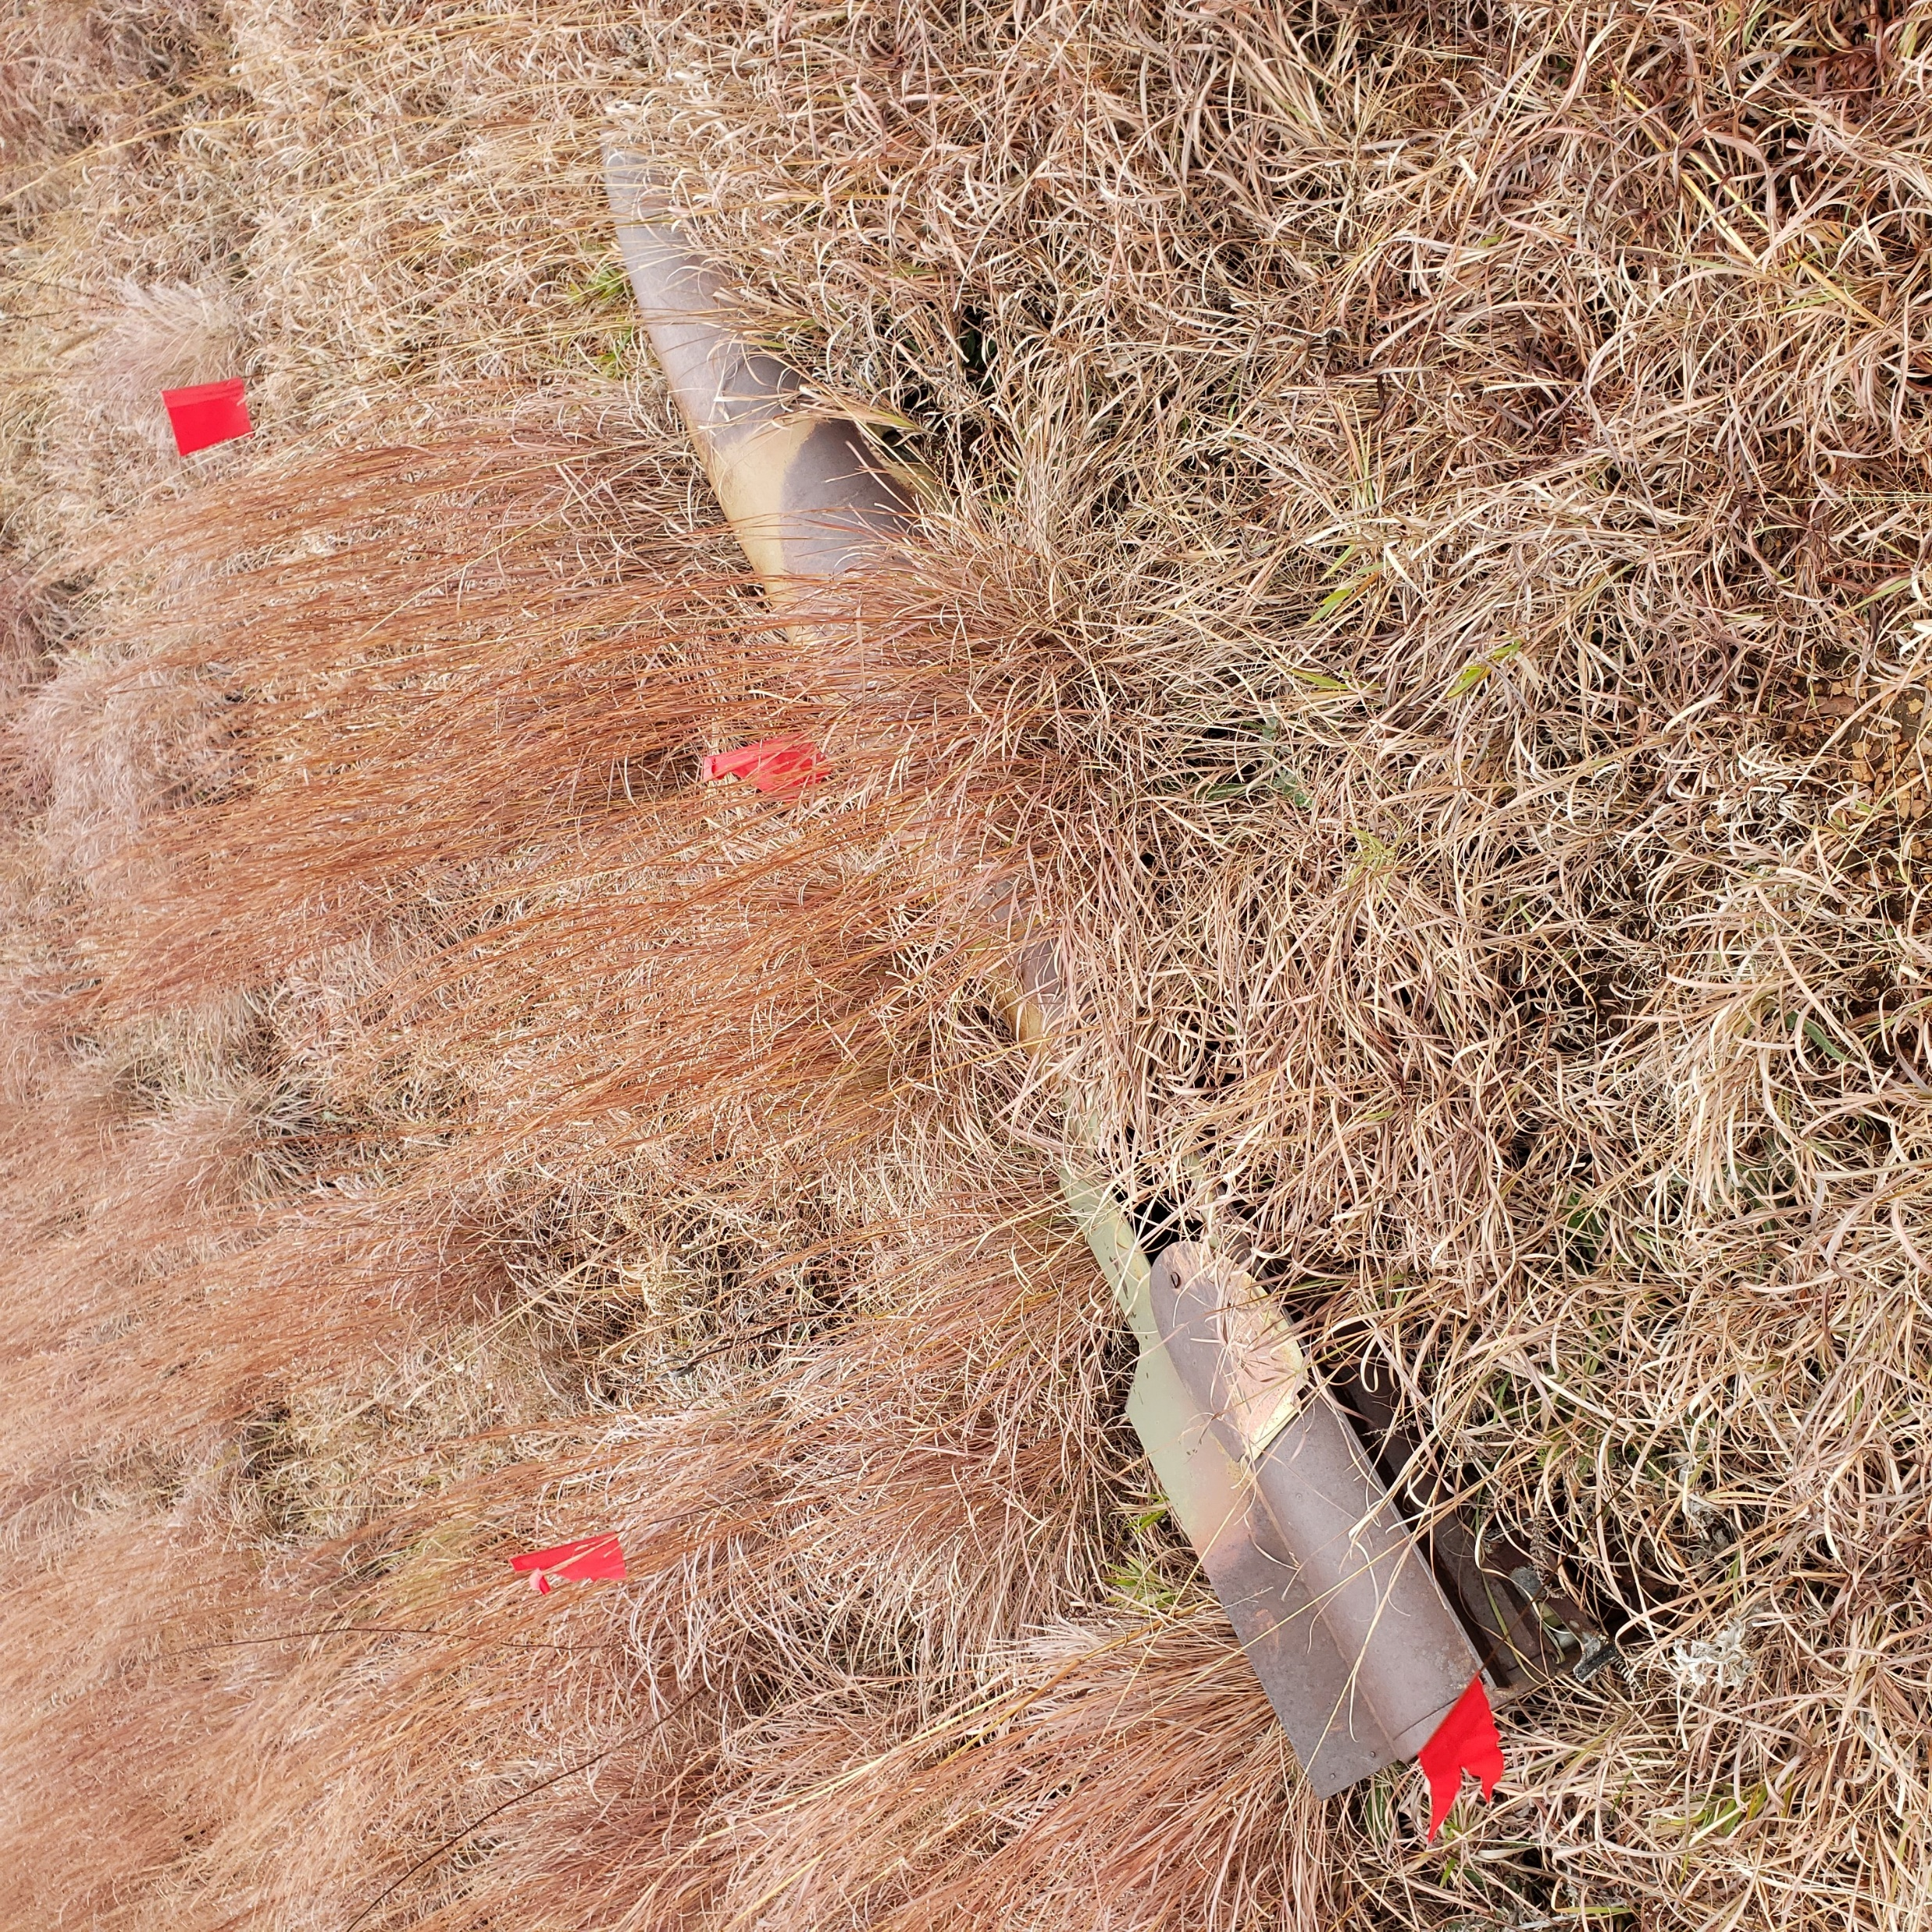
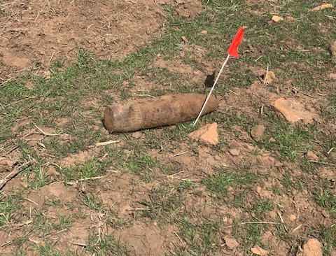
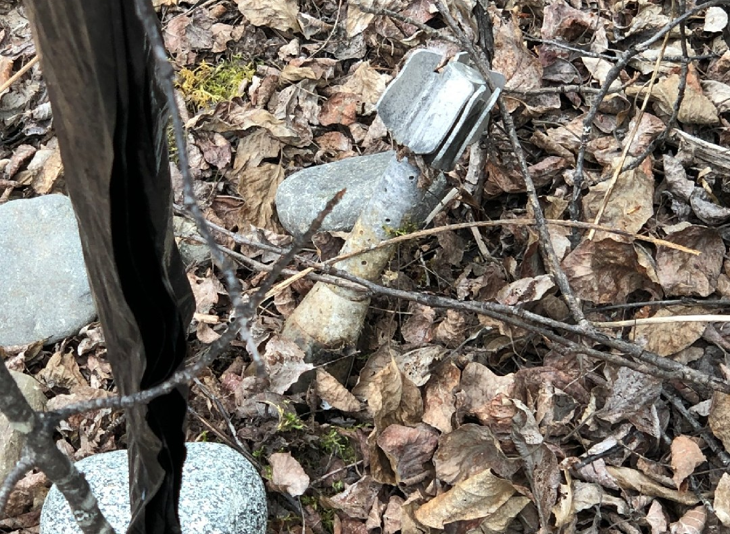




Some Munitions Are Hard To Identify
Explosives may be encountered anywhere
Photos: Munitions that blend into the environment.
Notes:
Notes:
Explain: Munitions can be encountered anywhere. Although military munitions will most likely be encountered in areas the military currently uses (e.g., operational ranges, tactical areas, area of operations), they may also be encountered in areas once used (former ranges) for live-fire training or testing, or that were once the site of tactical operations.
Discuss: These photos show munitions that can blend into the surrounding environment and be difficult to spot.
Additional examples of not recognizing munitions:
In 1995, a family on vacation near an active military base found seven unidentified items and took them home. These items turned out to be munitions. Two of these munitions exploded while children were playing with them. As a result, five children were injured and admitted to the hospital. Two were in serious condition, one with head injuries. An EOD Team responded from a local military base and destroyed the munitions. Unfortunately, the family did not recognize the items were munitions and the result was serious injuries.
What you don’t recognize can kill you.

Slide 6
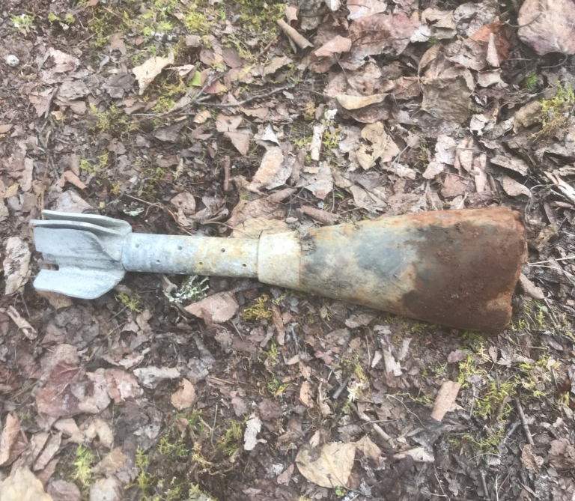
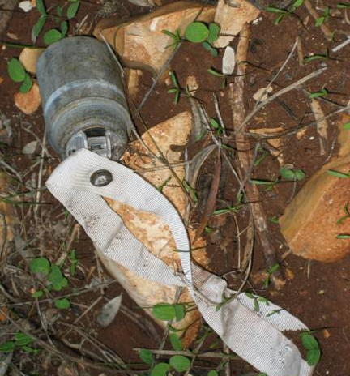
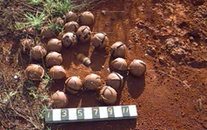
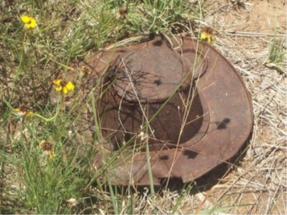
Munitions Vary In Appearance
Munitions are dangerous regardless
of appearance:
Munition type, shape, size, age, or condition doesn’t matter.
Flares, simulators, and blasting
caps are all dangerous.
Souvenir munitions can be dangerous.
Notes:
Notes:
Explain: As you can see from the pictures, munitions vary in appearance. For this reason, you should never pick up anything that you know, or suspect may be a munition.
Discuss: Munitions, such as those pictured here and throughout the presentation, vary in type, shape, size, age, and condition; consequently, they may be hard to identify as a munitions.
Military munitions:
- Come in many shapes, sizes and types
May not look like a munition (e.g., a projectile, grenade or bomb)
May be partially or completely buried in the dirt or covered by vegetation, sand, or other material; or partially or fully submerged in water
Use or natural phenomena (e.g., weather, corrosion) can alter a munition’s appearance.
In recent years, munitions have claimed lives. Although such munitions have remained unexploded for decades, aging does not make them safer.
Munitions marked with the word “simulator” or “practice” should be considered dangerous because most contain a small explosive charge that can cause serious injuries.

Slide 7



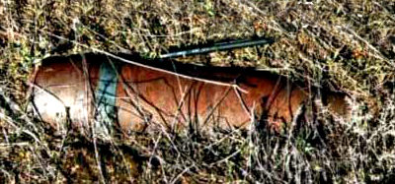
Artillery Projectile
New
Used
Notes:
Notes:
Discuss: This is an example of a munition before and after use.
The picture on the top shows a new, unused 105 mm projectile. The picture on the bottom shows a projectile that was fired but failed to function as intended - a UXO.
When a 105mm projectile detonates, metal pieces (fragments) from the projectile body travel at high speeds to distances up to 1,939 feet - the length of 6½ football fields! Anyone within this area could be severely injured or killed.

Slide 8

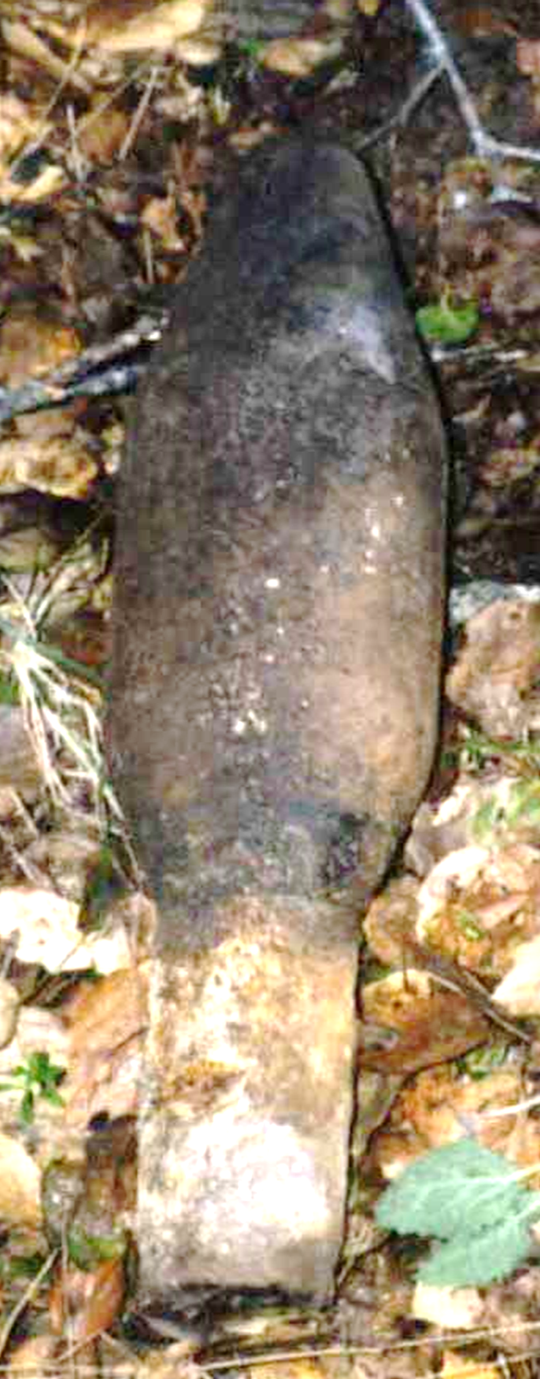
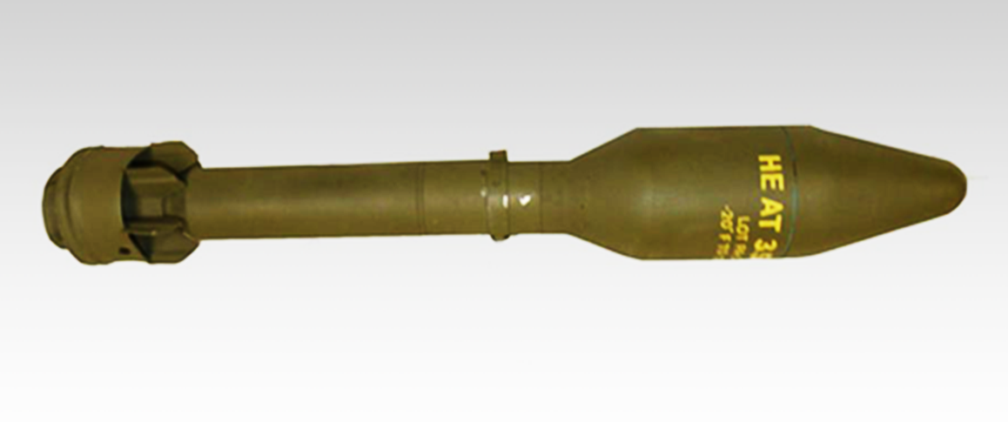
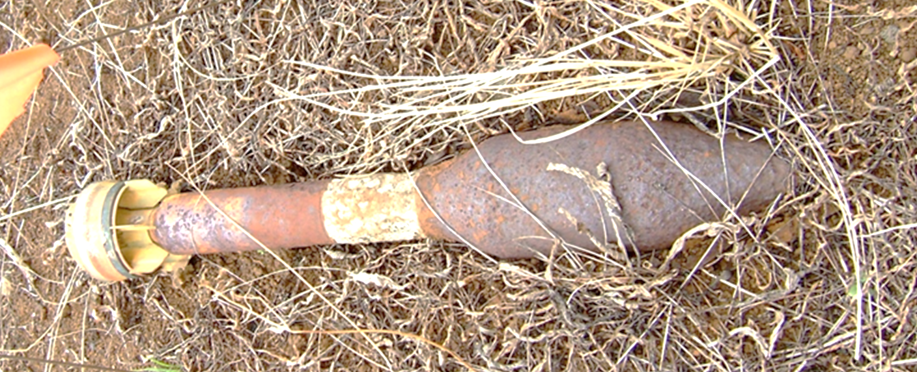
Rockets
Used
Notes:
Notes:
Discuss: This slide provides another example of a munition before and after use. The picture on the top shows a new rocket. The other two pictures show a rocket after use.
Upon detonation either on use or if disturbed as a UXO, people need to be 1,420 feet (almost 5 football fields) away to be safe from the blast and fragments! Anyone closer could be killed or severely injured.

Slide 9

  when you may have encountered a munition and that munitions are dangerous.
  Munitions are dangerous and may:
  not look like a bullet or bomb.
  be shiny or rusty.
  be clean or dirty.
  look harmless, but they are dangerous.
  Regardless of whether a munition has been moved, it may still explode.
Follow the 3Rs: Recognize
Notes:
Notes:
Explain: What do you do if you encounter a munition? Follow the 3Rs of Explosives Safety:
Stress:
Recognize - when you see a munition and that it is dangerous
Retreat - do not touch it, but carefully leave the area
Report – call local authorities to report what you saw
The first step is to Recognize that munitions are dangerous. If it looks like a bullet or bomb, treat it like it is one. Leave it alone! Recognize the potential danger!
But keep in mind that munitions may not be easy to recognize. They may not look like a bullet or bomb. They may be shiny or rusty, clean or dirty. They may look harmless, but they are dangerous and even small explosive devices, including simulators, can cause severe injuries or be deadly.
Discuss: The possible conditions a munition may be found in and the hazards with both new and used munitions.

Slide 10

Follow the 3Rs: Retreat
  Do not approach, touch, move, or disturb it, but carefully leave the area the same way you entered.
  In remote surroundings, mark the general area where you encountered a munition, so local authorities can locate it. DO NOT go closer to a munition when marking the area.
Notes:
Notes:
Discuss: The second step is to Retreat - Do not approach, touch, move, or disturb a munition or suspect munition. Carefully leaving the area the same way in which you entered may prevent disturbing it or other items that might be in the area. If possible, as you leave the area, mark it in some manner so that it can be found more easily later.

Slide 11

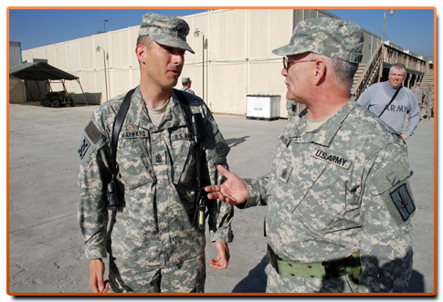
Follow the 3Rs: Report
Call
authorities
  Call local authorities to report what you saw and where
Notes:
Notes:
Explain: The last step is to Report. Describe what you saw and where you saw it. Trained Explosive Ordnance Disposal or EOD personnel will dispose of the item.
Add installation-specific telephone number(s) for reporting UXO to this slide. Note that there may be more than one number for reporting based on the location (i.e. cantonment area, range, or surrounding community).

Slide 12

Additional Resources
https://3Rs.mil
General Educational Resource Materials (Posters, Safety Guides, Fact Sheets)
Self-Guided 3Rs Training
Gallery of Photos
UXO Incidents
Information for Kids & Families, Military & Their Families, Communities, and Workers
Safety Clubhouse Games for Kids
3Rs Videos
Notes:
Notes:
Explain: If you would like additional information or resources for the Army’s 3Rs Program go to https://3Rs.mil. This website is an excellent resource for downloading presentations, videos, photos, handouts, and other resources.
Ask: Does anyone have any questions?
Demonstrate: https://3Rs.mil website

Slide 13



In Summary
Recognize - when you may have encountered a munition and that munitions are dangerous.
Retreat – do not approach, touch, move or disturb it, but carefully leave the area.
Report – Call local authorities
Notes:
Notes:
Review:
Munitions come in many shapes and sizes.
Munitions are designed to kill or injure people or destroy or damage equipment.
Exposure to the environment may change a munition’s appearance.
Do not assume a munition is safe, regardless of the age.
If you or someone else encounters something that might be a munition, follow the 3Rs (Recognize, Retreat, Report) of Explosives Safety.
To help protect yourself, your family and your friends, share the 3Rs message and what you learned with your family and your friends.
Provide: A thank you and closing appropriate to your audience and setting.

