Slide 1
Past as Process: Construction Delivery Methods and Historic Preservation
A Training Module to improve integration of regulatory preservation practices within Design Bid Build and Design Bid Department of Defense Projects
Notes:
Welcome to this self-directed webinar on Construction Processes. The purpose of this training is to provide a wide-ranging audience an understanding of how historic preservation coordination and consideration can be integrated into the construction process.
This presentation provides an overview of historic preservation requirements applicable to Federal agencies, as well as a focused description of two different construction delivery methods: Design Build and Design Bid Build. Case study examples are presented, followed by some suggested Best Practices to improve integration of cultural resource coordination into existing planning and project management processes.
In the world of public agencies, there is often an emphasis on involving “stakeholders” in the compliance process. Yet often it is hard to establish a collaborative relationship between cultural resource subject matter experts and their colleagues in the construction or facilities management teams. It is hoped this training slide deck, developed from the Department of Defense (DoD) Legacy Resource Management funded Guidebook and Technical report (DoD Legacy #16-787), will serve as a useful reference for this.

Slide 2
Background on DoD Legacy Resource Management Program project:
Department of Defense Legacy Project #16-787: Historic Buildings and Construction A Comparative Analysis of the Design-Bid-Build and Design-Build Process
Project developed from Texas Army National Guard Cultural Resource Program office staff addressing regulatory compliance issues with different construction delivery processes on projects impacting historic structures.
Researching the subject, TXARNG reached out to Nicholas Patrick, the author of a 2013 thesis on historic compliance issues and construction delivery methods to develop potential proposal for a project funded by the DoD Legacy Resource Management Program. To expand scope of study to outside of Texas, the team reached out to the Construction Engineering Research Laboratory at U.S. Army Engineer Research and Development Center to partner on full proposal.
In 2016, the DoD Legacy Resource Management Program awarded the project with a request to also include archaeological examples, and work proceeded.
Notes:
In 2015, the Texas Army National Guard (TXARNG) Cultural Resource Management (CRM) Program faced a wide range of maintenance and construction projects impacting the Camp Mabry National Register Historic District in Austin, Texas. Most TXARNG projects utilized a Design Bid Build (DBB) construction delivery system. In this system, a contract issued for “Type A” services creates the design and forms the framework for a “Request for Proposal” or “Invitation to Bid” to complete the project via a secondary contract issued to a General Contractor. During this process, the TXARNG CRM office Architectural Historian embedded within project management teams for all projects involving historic properties. This allowed the TXARNG CRM to share Maintenance and Treatment Plans for historic structures. These plans provide guidance on care and treatment of the significant historical features of a structure. Following this strategy lowered risks of adverse effects under Section 106 of the National Historic Preservation Act (NHPA) as well as the State Antiquities Landmark code requirements (Mabry is also a State Landmark).
However, TXARNG began to explore using a Design Build process in more recent projects. The CRM office was not familiar with how to integrate the required historic compliance coordination into this project process. Therefore, the TXARNG CRM initiated research on how to approach NHPA coordination to avoid delays to project timelines. As a result, the team found the thesis of Mr. Nicholas Patrick and reached out to him about assisting them in expanding its scope to help military CRMs address preservation compliance via these different processes. While originally focused on historic buildings and structures, the DoD Legacy Resource Management Program recommended expanding the scope to archaeological considerations. In addition to this training, a technical report and guidebook are part of the deliverables of this project, which can be found on the Legacy website at: https://www.denix.osd.mil/legacy/home/.
The project was informed by site visits to various DoD installations, as well as case studies provided by DoD installations.

Slide 3
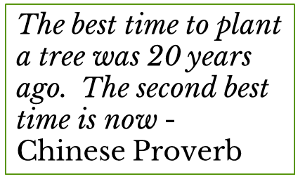
Outline
Introduction
Construction Delivery Processes (CDP)
Historical Regulatory Compliance (HRC)
Case Study Examples
Lessons Learned
  Sharing Responsibility: Avoid the Stovepipe and Focus on Dynamic Flow
Recommendations
Notes:
To quote a Chinese Proverb, “The best time to plant a tree was 20 years ago. The second-best time is now.”
Every DoD facility and installation is impacted by two realities:
There is never enough funding for EVERYTHING.
EVERYTHING needed to be finished YESTERDAY.
DoD facilities across the states and territories range from a small armory in an historic neighborhood of a major city to the family housing, airfields, administrative buildings and facilities of a large military installation spanning thousands of acres. All these structures and their related infrastructure require maintenance and management to keep them operational and safe for the soldiers and civilians working and sometimes living there. This requires many large installations or regional commands to provide planning and facilities services akin to city or county public works departments. However, because DoD is a public agency and its personnel serve as land managers, there is an added layer of responsibility in maintaining compliance with a vast array of environmental regulations, including those related to historic properties and areas of cultural significance, such as Traditional Cultural Properties (TCPs), Sacred Sites or traditional landscapes. Therefore, DoD facilities balance compliance with building and facilities regulations like United Facilities Codes, Anti Terrorism Force Protection, and Energy Efficiency rules, as well as the National Environmental Policy Act (NEPA), NHPA and other environmental compliance requirements (i.e., Endangered Species Act, Clean Water Act, etc.).
The goal of this course is to provide Cultural Resource Managers (CRM), as well as their colleagues across environmental and facilities management an overview of the relationship between Construction Delivery Processes (CDP) and Historical Regulatory Compliance (HRC). The course begins with a brief overview of the two primary construction delivery methods utilized in DoD contracting: Design Build and Design Bid Build, as well as other typical methods for maintenance and construction projects. An outline of CRM program function provides a background on their primary regulatory guidance function. A few examples of different types of projects are presented to demonstrate how HRC works within different CDP. The course ends with some recommendations to improve communication and coordination.
These slides will ideally plant a seed and encourage the user to explore the processes and procedures unique to their situation, whether they are at an installation or facility or a regional or headquarters office at different DoD services. It is important to emphasize the need to follow the specific service branches regulations and procedures related to cultural resources and work within a chain of command respectfully and properly to enhance coordination and integration.

Slide 4
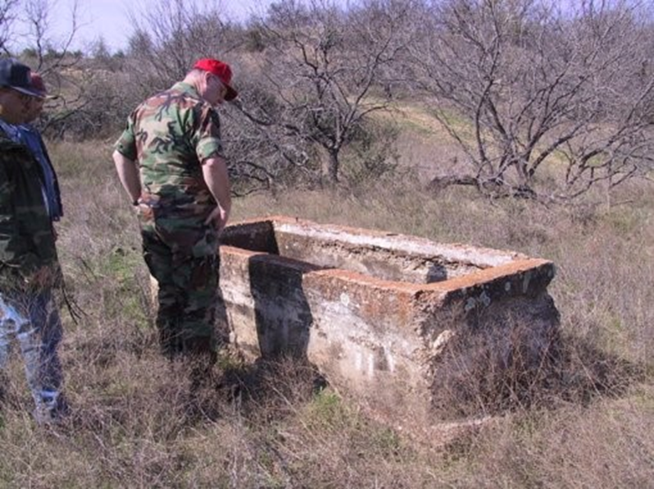
Links to Service Branch Discussion of Construction Methods:
Air Force: AF Instruction 32-1023 Designing and Constructing Military Construction Projects
Army: AR 420-1-2 Army Military Construction and Nonappropriated-Funded Construction Program Development and Execution
Navy: OPNAV Instruction 11010.20J Navy Facilities Projects
Inspecting early 1900s homestead features in Texas during range planning (courtesy of Texas Army National Guard circa 2003)
Notes:
To find details on DoD Construction processes and options, it is recommended to visit the following sites to take a deeper dive on the regulatory instructions guiding Facilities and Construction Management and Maintenance.
Air Force AFI 32-1023: Instruction on Designing and Constructing Military Construction Projects, found at: https://static.e-publishing.af.mil/production/1/af_a4/publication/afi32-1023/afi32-1023.pdf
Army: Army Military Construction and Non-appropriated-Funded Construction Program Development and Execution: https://armypubs.army.mil/epubs/DR_pubs/DR_a/pdf/web/PAM%20420-1-2.pdf
Navy: Navy Facilities Projects: https://www.secnav.navy.mil/doni/Directives/11000%20Facilities%20and%20Land%20Management%20Ashore/11-00%20Facilities%20and%20Activities%20Ashore%20Support/11010.20J.pdf

Slide 5
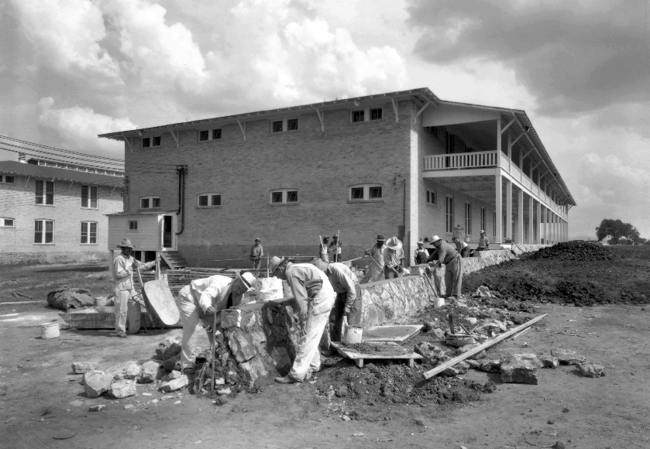
Historical Regulations and Construction
National Historic Preservation Act (NHPA): Directs public agencies to protect our Nation’s heritage via specific processes (Section 106) and procedures.
Secretary of Interior Standards for Treatment
Archaeological Resources Protection Act: This law requires permitting for the protection of subsurface archaeological sites.
Department of Defense Instruction 4715.16, Cultural Resources Management (DoDI 4715.16)
Works Progress Administration (WPA) and Civilian Conservation Corps: During the 1930s, many public works projects on installations were completed. Often these features remain and are protected under NHPA (TMD Photo)
Notes:
There are a wide range of historic federal, state, and agency regulations and laws that may relate to construction and maintenance activities. This brief overview slide focuses on the primary legal drivers with direct impacts on the planning and execution of DoD projects. For construction and maintenance professionals, it is important to note that it is not just above ground historic buildings or structures requiring compliance with preservation laws. Buried archaeological sites may can be impacted via ground disturbance, even in previously developed cantonments or training ranges. Sacred Sites of federally recognized tribal nations, as well as Traditional Cultural Properties important to these tribes or local descendant communities require consideration when planning and implementing projects. Cultural landscapes and viewsheds can be impacted by new construction.
National Historic Preservation Act (NHPA): The NHPA establishes processes and regulatory guidance to identify, evaluate and protect historic properties. Per NHPA, historic properties are defined as follows: ““prehistoric or historic district, site, building, structure, or object included in, or eligible for inclusion on, the National Register of Historic Places, including artifacts, records, and material remains related to such a property or resource.” Note that “historic properties” is a distinct definition from “cultural resources.” This is to allow CRM offices to address other types of resources defined in preservation rules and regulations, such as sacred sites, landscapes, objects of cultural patrimony as defined in Native American Graves Protection and Repatriation Act (NAGPRA), and archaeological sites as defined in the Archaeological Resources Protection Act (ARPA).
Secretary of Interior Standards for Treatment: To assist in maintaining and preserving historic materials, the National Park Service (NPS) maintains a set of standards for treatment of different historic materials types. These treatments provide agencies standardized guidance and language to reference in scoping services related to historic structures.
Department of Defense Instruction (DoDI) 4715.16 establishes policy for cultural resource management (CRM) programs. In the instruction, installations must prepare Integrated Cultural Resource Management Plans (ICRMP) to maintain compliance with historic preservation regulations. Across the DoD, many installations and facilities will have ICRMPs in place and in the rare circumstances when they do not, they will document this with a DoD approved variance memo. Whenever there are cultural resources present or potentially present, an ICRMP must be in place. Additionally, most of the time, an ICRMP requires a designated CRM officer/office to implement the plan.
Some useful links for non-CRM professionals related to preservation regulations are captured at the following websites:
Whole Building Design Guide: https://www.wbdg.org/design-objectives/historic-preservation
Government Services Administration (GSA): https://www.gsa.gov/real-estate/historic-preservation

Slide 6

Department of Defense Component Cultural Resource Regulations
Air Force:
  Air Force Manual 32-7003 Environmental Conservation
Army:
  Army Regulation 200-1 Environmental Protection and Enhancement
Navy: SECNAV Instruction Cultural Resource Management
Marines: Environmental Compliance and Protection Manual
Notes:
It is also recommended to consult with the specific service branch regulations on cultural resources, found on this slide.
This webinar, developed to be accessible for all DoD service branches, can be modified to include the specific guidance and regulatory information at the Headquarters and Installation levels as needed. What is important to note is that every Service Branch operates under regulations and directives specific to Cultural Resources Management.

Slide 7
Who Does What?
CRM Office
Construction/Facilities Office Directorate of Public Works *
Identify and evaluate cultural resources (includes buildings, structures, landscapes, buried and submerged sites, traditional cultural properties related to Tribes or local communities)
Develop management procedures and protocols for preservation
Provide Subject Matter Expertise (SME) to Decision Makers at the Installation
Coordinate with the State Historic Preservation Office, federally recognized Tribes, external stakeholders
Implement Integrated Cultural Resource Management Plan (ICRMP) or equivalent program
Planning and Programming for Installation Sustainment and Operations
Real Property Management
Maintenance Activities
Project Management for Major and Minor Construction
Resources and Funding
Contracting Offices
Notes:
Most Military Departments include a Construction/Facilities Management Office (CFMO) or Directorate of Public Works (DPW) responsible for the operations and maintenance of facilities and lands. These departments are quite large and can include a wide range of offices with different functions. While each military department or installation may have slightly different organization, their purpose will be similar. Most Military Departments’ environmental regulations direct installations to maintain a CRM office or program to manage cultural resources. Cultural resources is a general term used to encompass the wide range of resources that can be protected under federal and state regulations. This can include historic buildings and structures, landscapes (both natural and built), buried and submerged (underwater) archaeological sites, sacred sites utilized by Native American, Hawaiians or Alaskans, and Traditional Cultural Properties (TCPs) related to either Native Americans, Hawaiians or Alaskans or local communities.
What is a CRM office/program?
Organizationally, CRM programs are part of larger environmental branches or directorates. Environmental branches also include programs for natural resources (forestry, biology, wildland fire), clean air and water programs, pest management, National Environmental Policy Act (NEPA), Resource Conservation and Recovery Act (RCRA), pollution prevention and other support programs for stewardship. The funding to support environmental efforts are allocated separately from general operations and maintenance funding. However, most environmental programs are located within the directorates responsible for installations/facilities management.
At the DoD level, the Office of the Assistant Secretary of Defense for Sustainment includes the Environment and Energy Resilience office within which the Environment Directorate includes cultural resources (https://www.acq.osd.mil/log/ENV/index.html). Every service branch will be organized along similar tiers. For example, at the TXARNG, the CRM office is part of the Environmental Branch, which is part of the Construction Facilities Management Office (CFMO). At the Army National Guard level, the CRM office is part of the Conservation Branch, which is part of a larger division within the G-9 Installations and Environment Directorate (as of March 2022).
CRM programs, whether at headquarters (U.S. Army), sub-command (IMCOM), or installation (Fort Hood), focus on preservation and management of cultural resources in support of the military mission. This means the CRM must balance stewardship of what are essentially non-renewable resources with mission activities. The regulatory requirement focuses on avoiding “adverse impacts” to cultural resources. Because once a military convoy drives through an archaeological site on the surface or a new addition is added to a historic building without CRM coordination, the damage is considered “adverse” and irreversible, resulting in costly mitigations and possible delays to mission activities to negotiate out agreement documents such as Memorandum of Agreements (MOAs). Therefore, the goal is for CRM offices to integrate procedures and processes (usually spelled out in the relevant ICRMP) with the Mission’s organizational activities to manage preservation activities efficiently and effectively.

Slide 8
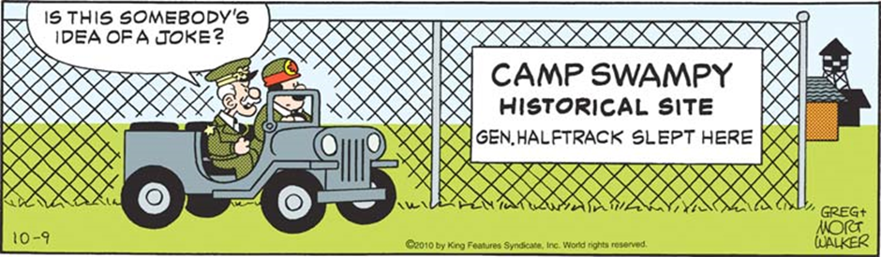
Starting at the Very Beginning….
Construction, Facilities Maintenance, Public Works programs manage projects large and small across DoD installations, including new construction, renovations of buildings and support structures, airfields and hangar construction, infrastructure (roads, fences, utilities, ports, waterways), and construction of and updates to training ranges.
Their budgets are always tight and the myriad of regulatory requirements vast, with all demanding placing demands on budget and time commitments on the schedule.
Notes:
As General Halftrack exclaims to his driver, the concept of historic sites is not always met with the same enthusiastic reception by all users or tenants. Particularly for staff working within a very busy planning facilities program, where they juggle maintenance and modernizations, new construction and requirements related to energy efficiency, anti-terrorism force protection, cyber security and other updates to codes. Additional requirements, particularly ones related to preservation with the potential to conflict with other regulations, can result in attitudes like General Halftrack.
The myriad of policies for both military construction, maintenance and preservation, often exist independently and sometimes in contradiction of each other, resulting in the communication exchange between a cultural resource program and the construction and maintenance programs occurs very differently across service branches, regions and facilities. This presentation is not here to replace existing trainings or guidance across Department of Defense, this is a course to help explain how construction is carried out so that CRMs may understand a little more about the processes and timelines to assist them in their roles as a Subject Matter Expert (SME) providing guidance to decision makers and to help improve efficiency and effectiveness of regulatory coordination.

Slide 9
Learning the Lingo
Design Bid Build (DBB)
Design Build (DB)
Contract awarded to Designer (Architect/Engineer=A/E) for development of design documents for Construction.
Construction awarded separate contract.
Longer timelines and greater costs overall due to change orders late in process.
Agency maintains control on changes, meaning cultural resource issues may be considered and addressed within timelines.
One contract awarded for Design and Construction Services.
Single point of responsibility: the Contractor.
Short project duration due to overlap of construction and design.
Agency (owner) loses control on design and means/methods, which can impact cultural resource considerations.
Notes:
Design-Bid-Build (DBB), also known as ‘hard-bid’ or “traditional method,’ is a type of project delivery system where the owner holds two separate contracts, one with the designer and another with the contractor. The designer assists the owner in developing the program and is responsible for design and the development of drawings and specifications. The contractor is responsible for means, methods, and actual construction of the project. There are three main sequential phases to the Design-Bid-Build delivery system: the design phase; the bidding (or tender) phase; and the construction phase. The bidding phase is unique to DBB. In the past, DoD tended to use this delivery method although over the years, there has been increasing use of Design Build. The general assumption with DBB is that the projects take longer and can cost more due to multiple contracts and associated costs.
DBB projects provide not only longer timelines but greater involvement of architects/design teams. As a result, from a cultural resources perspective, this allows for sufficient consideration of not only regulatory timelines for completing the Section 106 NHPA compliance required, but also to develop treatments and considerations for cultural resources. It is especially advantageous for situations where inadvertent discoveries are encountered in cultural resources. For example, if removal of a dropped ceiling finds there is original beadboard still in place, it may be possible to develop a change order to alter the design and incorporate preservation of the original materials in the project. Of course, the flip side of this process is that DBB projects often end up costing much more money than originally budgeted due to the Change Order process.
Design-Build (DB) is a method in which the design and construction services are contracted by a single entity known as the Design-Builder or Design-Build contractor. There are two main sequential phases to the Design-Build delivery system: the design phase and the construction phase. Design–build relies on a single point of responsibility contract for the two project phases. DB projects usually are less expensive and on time in delivery. The drawback is that projects sometimes do not allow for as much owner control on certain design elements and costs can be high to alter design due to unanticipated discoveries or issues, which can be common in preservation settings.
DB projects are rapidly becoming very popular across federal agencies, including the DoD, as a more efficient process, both from a cost and time perspective. However, because the contracted DB firm becomes the “owner” of the entire process, from design to construction, the agency loses control on addressing alternatives or changes to project. To ensure input into the design process, most DB projects will begin with “Charrettes” to allow stakeholders to provide inputs on project needs and issues, including cultural resource compliance issues. If a DB process ensures inclusion of the proper SME to participate in the charrette process, then it is likely that preservation issues can be identified and addressed in advance. However, with limited options to change course in design or budget, it makes situations where inadvertent discoveries or changes to a historic material treatment (i.e., windows or flooring) out of control of the agency unless scoping and direction is clear on processes.

Slide 10
Additional Methods and Processes
Minor Maintenance Projects
Troop Labor/Self Help Projects
Scoping and Design limited.
May utilize existing contracts for services.
Environmental review periods may be limited, which may pose challenges for Cultural Resource concerns.
Minor construction and maintenance may utilize this process.
Project scoping may be limited.
Design may be absent.
Difficult to coordinate cultural resource compliance with no firm scoping or design.
Notes:
Smaller projects often utilize contracts where there are no designs or plans due to the scale of the project. It is important for a CRM office to be aware of the smaller projects as well because regulatory compliance isn’t based on the size and scale of an undertaking, it is based on the potential for the activities to adversely effect cultural resources.
Minor Maintenance Projects: These types of projects may include minor modifications and repairs to historic buildings and structures, placement of signage or utility lines, pavement or foundations for structures, clearance of brush from fence lines, placement of protective barriers, replacements of doors or windows for security purposes, addition of solar panels or energy efficiency measures, hardening of low water crossings on roads, etc. The critical issues are: 1) Is the project impacting a protected cultural resources (building, buried archaeological site, district, etc.) and 2) Have proper cultural inventories and evaluations been completed if required? At most installations, there are procedures to ensure for environmental reviews of these types of smaller projects, whether it is an online work request system, a dig permit process, a project review meeting or a NEPA review to determine level of regulatory coordination. It is recommended that CRM offices identify the procedures and offices managing minor maintenance and share relevant awareness materials, provide training on ICRMP use and procedures, and establish familiarity so personnel will be encouraged to reach out to the CRM when needed.
Troop Labor/Self Help Projects: In addition to installation or facility maintenance staff, many service branches also utilize troop labor or self-help projects to maintain their facilities and provide on the job training opportunities to soldier units, particularly for those with engineers or construction specialists. In these situations, projects may not follow a traditional planning and programming process. Notifications about a proposed troop labor/self help project may only be made with short notice for a variety of reasons. CRM staff working on installations with large historic districts or large numbers of historic buildings should work to ensure that design guidelines are developed and available to any tenants and to quickly provide project managers with appropriate conditions for working on specific cultural resources.

Slide 11
“Traditional” CRM Regulatory Coordination
Focus: Compliance with Regulations
Emphasis on Inventory and Evaluation for historic properties
Section 106 Scenarios:
  Avoid Adverse Effect: Work conducted in compliance with Secretary of Interior Standards, apply Alternative procedures/Program comments, no properties impacted.
  Mitigate: Enter into agreement to implement certain activities to offset the adverse effect.
Identify structures over 50 years old
Manage Section 106 Compliance effectively
Request Funding for Historical Inventory and Evaluation
Typically where CRM interacts with internal stakeholders
"Preserve"
Complete Evaluations for Eligibility for National Register
Notes:
Most CRM offices follow what is called here a “Traditional” CRM regulatory coordination cycle. The focus is on compliance with regulations in support of the agency’s mission. The emphasis is preservation with no net loss of mission activities. Program focus is on inventory and evaluation to identify where historic properties are and whether they require preservation due to their eligibility for the National Register of Historic Places or potential function as a sacred site as identified in Executive Order 13007 (for more information see: https://www.achp.gov/digital-library-section-106-landing/relationship-between-executive-order-13007-regarding-Indian).
The goal for DoD agencies is to preserve significant historic properties in place via avoidance and various types of agreement documents to maintain compliance and avoid adverse effects. Many of these agreement documents focus on mitigation, which can encompass implementing specific treatments for historic properties, documenting prior to the adverse effect, conducting large scale data recovery on archaeological sites, and/or creative alternatives like public interest projects (traveling museum exhibits, publications and videos).

Slide 12
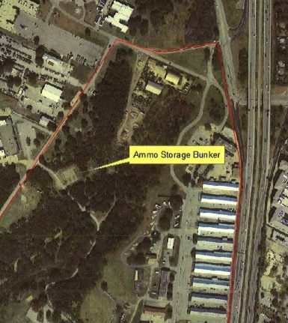
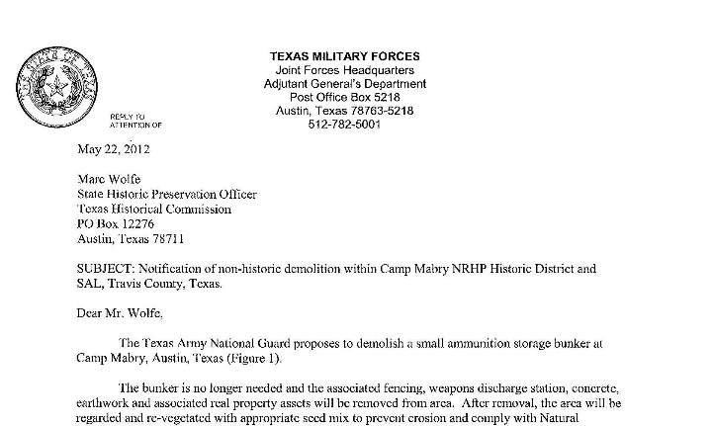
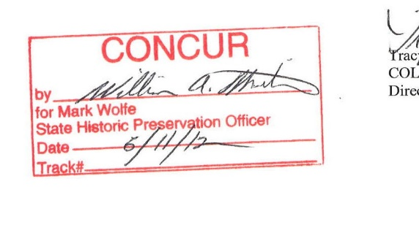
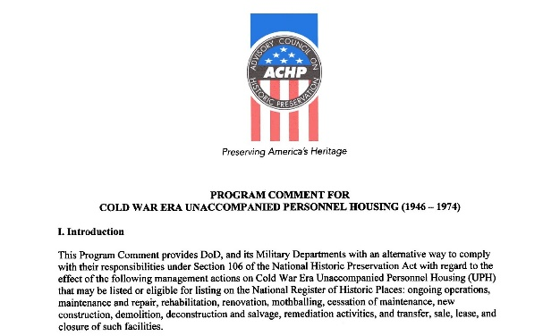
Traditional Role: Section 106
Traditional Approach:
  Receive Notification of Proposed Undertakings (Projects)
  Identify Need for National Historic Preservation Act (NHPA) Review or if an existing Nationwide or Installation Agreement document or Alternative Procedure applicable? (ex: Program Comment on Cold War era Unaccompanied Personnel Housing)
  The Cultural Resource Management Office (CRM) completes surveys, evaluations, and/or documentation and sends to the State Historic Preservation Office (SHPO), Tribal Historic Preservation Office (THPO) and potential interested public if applicable.
  Notify Project Manager of Approval of Project (or Need for Negotiating an Adverse Effect)
  Negotiate out Agreements as needed with timeline in advance of project proceeding to kick-off.
Notes:
In most construction project settings, the CRM will be functioning to support regulatory compliance with Section 106 of the NHPA.
As can be seen here, the traditional steps that are followed for a CRM are:
Receive notification of the proposed project (whether in a project review meeting, an online or paper environmental review, or via an annual work plan).
The CRM will determine if the proposed undertaking requires NHPA review or if it is covered under any existing Nationwide agreement documents.
The CRM will review existing databases and ensure any required surveys and evaluations are completed. At this point, it is important to point out that Planning and Programming for construction and maintenance requires early environmental review, as the project proponent is often responsible for funding any required compliance activities to move forward. This information will be submitted to consulting partners (SHPO, THPO, etc.) for review and concurrence within 30 days of receipt of materials.
If it is expected that adverse effects cannot be avoided, negotiation to mitigate those effects will take place and usually involve the installation/facility regional or Headquarters organization and the Advisory Council on Historic Preservation.

Slide 13
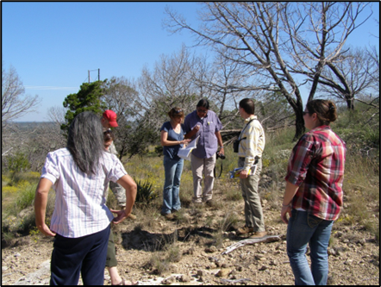
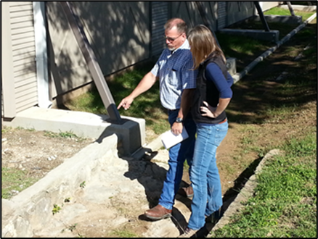
“Non-Traditional CRM”: Enterprise Approach
What does it mean and how can it work effectively?
Reviewing impacts to archaeological site near road at Camp Bowie, Texas (courtesy of Texas Army National Guard)
Discussing historic masonry at Camp Mabry, Texas (courtesy of Texas Army National Guard)
Notes:
Across the DoD Military Departments, the early years of CRM programs and guidance necessitated a very focused approach to meet the regulations and “check the boxes” of the necessary compliance. In some ways, CRM offices functioned as internal SHPO offices, receiving and reviewing materials in the same manner as a regulatory partner. This, of course, is a critical function especially if installations are utilizing alternatives to standard NHPA coordination that necessitate a professional CRM to function as an “internal SHPO” for compliance. However, the DoD soon realized the necessity of integrating cultural resource management issues within existing activities to foster stewardship and responsibility across installations and departments.
The first step directing this effort is the requirement for an Integrated Cultural Resource Management Plan (ICRMP). These documents must be developed with both INTERNAL and EXTERNAL stakeholder input. What does that mean? It means that CRM offices must meet with their colleagues who will be directed responsibilities and roles in the Plan to solicit their input and comments. It also means that the documents will be shared with external partners, including SHPO offices, Tribes and general public. An ICRMP must include an overview of activities carried out by the organization (i.e., installation), the location of facilities and lands managed by the organization, the existing cultural resources identified and need for future surveys, a 5-year CRM project/program plan, Standard Operating Procedures for cultural resources, lists of stakeholders, and other guidance and documentation. While many may think the completed ICRMP can sit on a shelf with annual updates by the CRM, the concept is that the ICRMP becomes an active resource available to all for guiding them through cultural resource management, particularly non-CRMs.
A fully integrated ICRMP will include processes for CRM involvement in planning and project reviews to identify compliance issues early and work to avoid adverse effects or begin conversations to resolve them with adequate time and resources. In the following case studies, one can see some “non-Traditional CRM” approaches to compliance via Design Build and Design Bid Build projects. To help frame that context, as the reader goes through the slides, consider their examples in contrast to a standard “traditional CRM” approach:
The project team sends the CRM office a project notification and start date in 60 days. The packet may or may not include detailed scope and design plans.
The CRM identifies activity as subject to NHPA Section 106 review and prepares a letter and sends to the SHPO and Tribes.
The SHPO says it needs more information before it can complete review and Tribes ask if there are any surveys completed for Traditional Cultural Properties (TCP).
The CRM goes back to the project manager and requests more details and says there may be a need to complete a survey for TCPs. The CRM needs to know if the Project manager can fund the survey as the proponent must pay.
The Project Manager did not expect this cost and it is not included in budget, the CRM must now go back to Tribes and determine if they will agree to alternatives to keep project moving forward. SHPO receives additional information and is concerned the project will impact viewshed of adjacent Historic District. They request consultation to resolve adverse effects.
The Project must go on hold as consultation process with SHPO and Tribes begin.

Slide 14
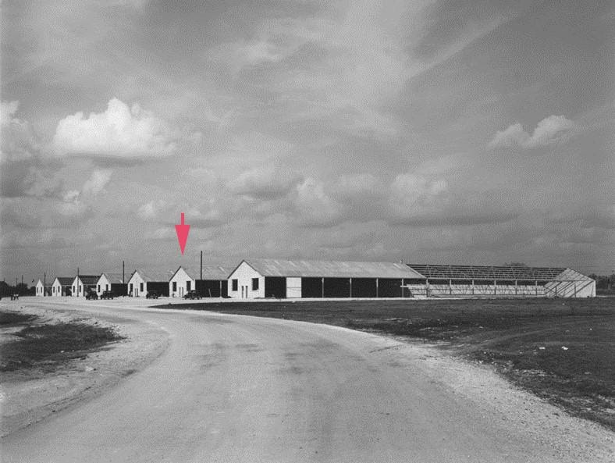
Case Study 1: Design Build Building 38 at Camp Mabry, Austin, Texas
Design Build with Troop Labor
1941 Works Progress Administration (WPA) constructed warehouse, contributing to the NRHP district in 1996.
Convert partially unconditioned interior offices and storage space into fully conditioned administrative offices.
Building 38 shown with red arrow in Camp Mabry photo from 1941 (courtesy of Texas Army National Guard)
Notes:
In this first example of a Design Build construction project, the TXARNG initiates a rehabilitation of a 1941 WPA warehouse to meet needs for more administrative space at Camp Mabry in Austin, Texas. Due to funding and timeline constraints, an additional twist is added to the Design Build process with the incorporation of troop labor to assist with the initial demolition of existing interior.
This example shows how an integrated team, where the CRM office educated Construction Facilities Management Office (CFMO) team members on historic buildings and compliance requirements helped move a project forward with no adverse effects, avoiding the cost and time of a Memorandum of Agreement mitigation document.

Slide 15
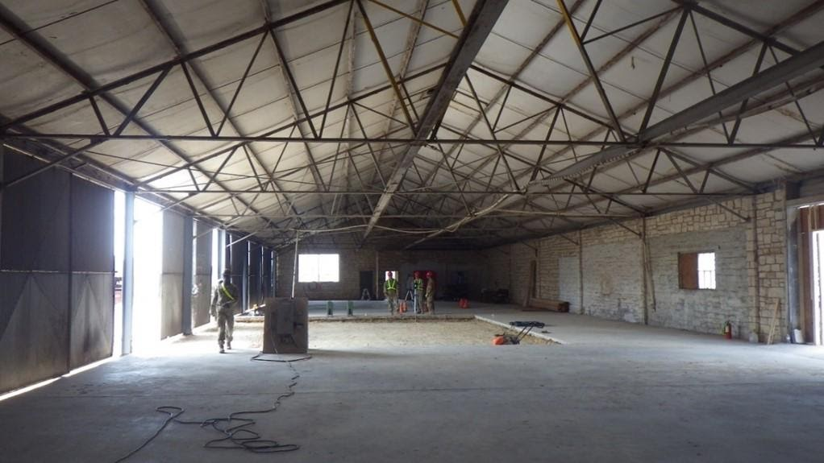
Case Study 1: Design Build Building 38 at Camp Mabry, Austin, Texas
Design at 35% when demo work for troop labor planned with limited window of opportunity.
The TX CRM and Construction Facilities Management Officer met with SHPO to get initial approval for demo and 35% design.
As project progressed, changes in project manager and expansion of troop labor to other tasks created some complexity in project execution, particularly as design was happening at same time as work.
Interior during demolition (courtesy of Texas Army National Guard)
Notes:
The main issues in this “Design Build” process were tied to controlling the design documents as the construction process proceeded. With the early initiation of project with troop labor using early design at 35-65%, it was important to keep track of important elements, particularly the plumbing, mechanical, electrical and communications elements. The original troop labor was planned for the demolition phase only and when they were tasked with additional scope of duties, it created disconnects between the design development and execution on the ground. Ultimately, there were no negative impacts to the historical fabric of the building, but the time delay in the renovation has the unintended impact of creating a potentially negative mindset about historic renovations.
As the project proceeded through stages, any obstacles hit were usually due to issues with communication. When the initial project manager deployed, the new project manager did not have awareness of the need to communicate changes in the design plans with the Cultural Resource Manager (CRM). This change also impacted the overall project as the design process continued in midst of construction, details on the 65% design plans were inadvertently overlooked and had impacts for completion when telecom drops were not installed for the open cubicle areas. In this project, the pace of rehabilitation was fast but issues in managing design and alterations to plans made for unanticipated costs and some extension of the completion timeline.

Slide 16
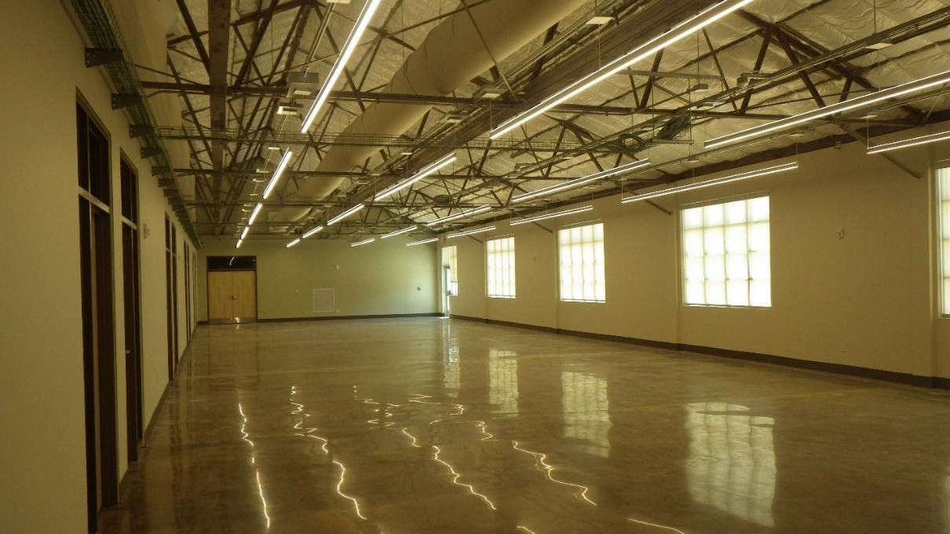
Case Study 1: Design Build Building 38 at Camp Mabry, Austin, Texas
Communication Key:
  Between CRM and Construction Project Manager & Architect
  Between CRM and SHPO
  Between CRM and Troop Labor Unit
Interior after completion (courtesy of Texas Army National Guard)
Notes:
When the building renovation was completed, the final product was indeed less costly than new construction or a major rehabilitation project. Following a Design Build model provided opportunities to adjust the design as issues were encountered, but managing these changes was impacted by the change in project manager.
Communication and positive relationships between the CFMO, the CRM and the SHPO was critical to the success of the product, in terms of regulatory coordination and mission need. Sitting down with the SHPO to explain situation and ask for a Section 106 review on 35% design and approvals for interior demolition to proceed helped avoid delays to project timeline. Including the CFMO Project Manager in the SHPO discussions ensured the SHPO could ask technical questions during meeting and the PM could understand the critical concerns for compliance. Keeping the SHPO updated as design proceeded to 100% and notifying them of any alterations in those plans also maintained trust with the office.
Communication also was important to the troop labor unit working on the building. The CRM conducted briefing to alert them to significant materials and elements of building to ensure demolition did not result in damage to them. Repair of masonry was completed with guidance from the CRM and a TXARNG maintenance technician knowledgeable about proper mortar mix and techniques.

Slide 17
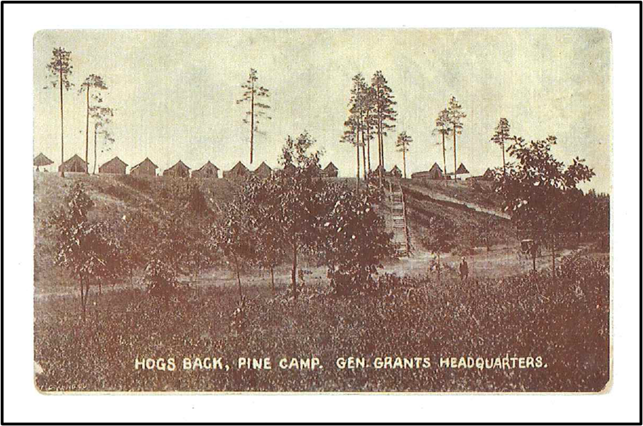
Case Study 2: Design Build for New Airfield Barracks, Fort Drum, New York
The Great Bend of the Black River is a highly sensitive area for archaeological resources, including:
  Native American Sites spanning 13,000 years
  Historic Military encampments and sites from early 1900s.
Airfield Barracks were proposed with a short project timeline to meet need of a returning brigade.
Fort Drum Cultural Resources Team required 2 years to plan and complete surveys and evaluations, which was not possible based on project timeline.
Historic Photo of the Hogs back (courtesy of Fort Drum Cultural Resource Management Program)
Notes:
Fort Drum’s Wheeler-Sack Airfield is located just north of the Great Bend of the Black River, a waterway which has been a key route for indigenous people for over 13,000 years. In 2004, the Fort Drum engineers approached the Fort Drum cultural resource program with a proposal to place barracks in the northern sandy bluffs of the Black River, an area highly likely to contain archaeological sites spanning the 13,000 years. Additionally, this portion of Fort Drum is also the most historic in terms of military occupation. The cavalry began training on this area of the installation in 1907, with officers’ tents placed at the summit of a sand mound called the “Hogs Back,” where they had an excellent view of the cavalry spread out below. The first commanding officer to bring Soldiers to train at Fort Drum was Frederick Dent Grant, son of Ulysses S. Grant.
The 2004 project was rapidly planned due to concerns about availability of housing for a returning brigade. The project was presented to the Fort Drum Cultural Resources Team (CRM*) at the end of their field season, as winter was setting in. Normally the team requires a 2-year notification for projects in highly sensitive archaeological areas where surveys and evaluations of potential historic properties for National Register of Historic Places eligibility are necessary.
Ordinarily the Fort Drum CRM requests all construction project footprints to be submitted at least two years prior to proposed groundbreaking in order to allow, not only for archaeological survey, but also for an opportunity to complete evaluation of any finds for National Register status and/or to adjust the proposed footprint to achieve site avoidance. Clearly, receiving a project proposal after termination of the field crew for the winter with a request for early spring construction offered a significant challenge.
* Note for consistency CRM is used here for consistency with other examples versus the proper Fort Drum CR Team.

Slide 18
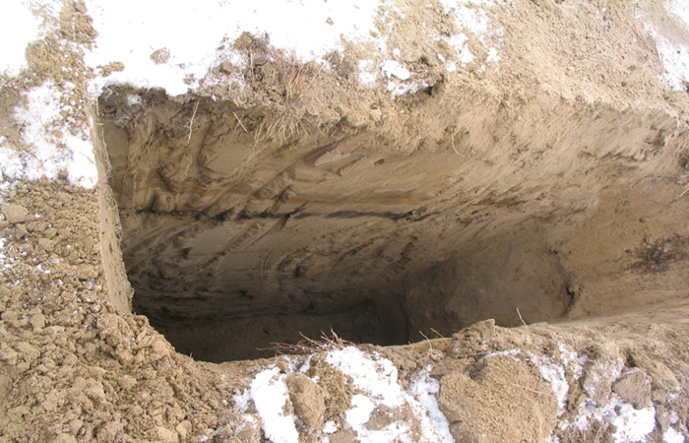
Case Study 2: Design Build Airfield Barracks, Fort Drum, New York
Winter weather limited options for standard archaeological inventory and evaluation.
CR Team used historic maps and archives to determine area least likely to have buried archaeological deposits.
7 Test trenches were placed to verify absence of deposits.
Example of test excavation (courtesy of Fort Drum)
Notes:
The proposed barracks consisted of a footprint containing twenty-five (25) modular barracks structures each measuring 70’x140’ plus a community building. Because the planners had reached out to the CRM as quickly as possible, they had flexibility to adjust project footprint based on their recommendations.
Given the challenge of weather preventing the traditional shovel testing approach for survey of the proposed project area, the CRM used historical knowledge of damage in the area to locate the barracks in an area with minimal risk of damage to potential archaeological deposits. The CRM team analyzed historic maps and a series of aerial images dating back to 1940 in order to estimate the boundaries of soil destruction and removal within the landform.
Once this footprint was identified, the team decided to test the proposed area using excavation with heavy equipment in order to view soil profiles in order to confirm whether soils had been removed and/or soil depositional integrity had been destroyed. A series of seven test excavations approximately 3-5m deep and 1-2 meters wide were monitored and photographed by the Fort Drum archaeology program coordinator. All the excavations were negative for any type of artifact or feature, and two of the excavations showed extreme soil disturbance. With the negative results, the CRM team made recommendations for preferred location of barracks, which the Plan and Design team implemented.

Slide 19
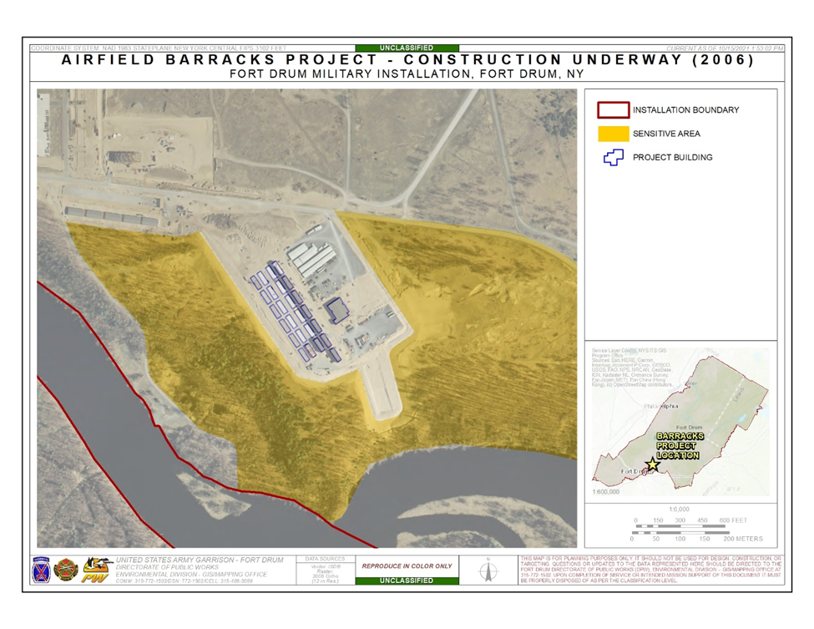
Case Study 2: Design Build Airfield Barracks, Fort Drum, New York
Section 106 Notifications to State SHPO and 3 Tribal Nations expedited.
“Even If It’s Only a Dream…” Fort Drum CRM office meets regularly with planners and engineers to discuss concepts and locations well in advance of formal funding requests.
Airfield Barracks project map showing location avoiding sensitive areas (courtesy of Fort Drum)
Notes:
Under normal circumstances, when the Fort Drum archaeological survey has the luxury of multiple field seasons to consider a proposed project area, the CRM program submits its findings and recommendations to the New York State Office of Historic Preservation (SHPO) and Fort Drum’s three Native American Partner Nations, the Oneida Indian Nation, the Onondaga Nation, and the St. Regis Mohawk Tribe in an annual report. However, in this situation, the survey and proposed project had to be submitted simultaneously for a standard 30-day review. The project did not receive any non-concurrence notifications from consulting parties, so it was able to proceed.
While this Design Build project posed problems to the CRM team, they took a lesson learned and initiated a program to address similar scenarios and ensure there could be discussion and input to the planners and engineers on preferred siting for footprints, design elements of structures, etc. They implemented the “Even If It’s Only a Dream…” program. This effort includes office calls, especially in the middle of winter so that the archaeological survey could begin prioritizing the next season’s survey priorities. The CRM team discusses proposed footprints, project ideas, alternative locations, associated infrastructure disturbance like borrows, spoil piles, laydown areas, and wetlands mitigation sites, potential year for funding, and potential for ever being built. This type of information has enabled the cultural resources program to be more effective in prioritization of survey efforts and has prevented a recurrence of learning about a spring project after the archaeological field season has ended.

Slide 20
Case Study 3: Design Bid Build Camp Mabry Building 1
Building 1 2011 Maintenance and Treatment Report: Construction Facilities Management Office (CFMO) staff used guidance from a CRM report to begin project development with immediate focus on historic issues. The RFP required the bidders to include historic subject matter experts, from a consultant historic architect for the design phase to securing qualified sub-contractors in relevant trades, such as window repairs and masonry rehabilitation.
Team Approach: The TMD CRM team (manager and architectural historian) participated in all major meetings from scope development to the project kick-off, to commenting on design documents and on-going construction meetings. The TMD architectural historian was part of the final inspection team to approve all relevant historic treatments and materials.
Notes:
The Camp Mabry National Register Historic District is as 221-acre district with multiple buildings and features contributing to its significance. Camp Mabry serves as the headquarters for the Texas Army National Guard, the Texas Air National Guard, and the Texas State Guard, as well as the civilian state agency the Texas Military Department. The District was listed in 1996 and is also a State Antiquities Landmark.
In 2011, the CRM contracted a Maintenance and Treatment Plan to provide assessment of current conditions of historic materials in the building with recommended treatments and costs prioritized. It also included assessment of different alternatives to treatment of the building and their associated costs based on historic materials conditions and preservation significance. In 2008, a Historic Landscape Plan had been completed for the District as well, which included general guidance and recommendations for the zone including Building 1. Both these documents would be helpful in the subsequent programming, scoping and design for the building’s rehabilitation.

Slide 21
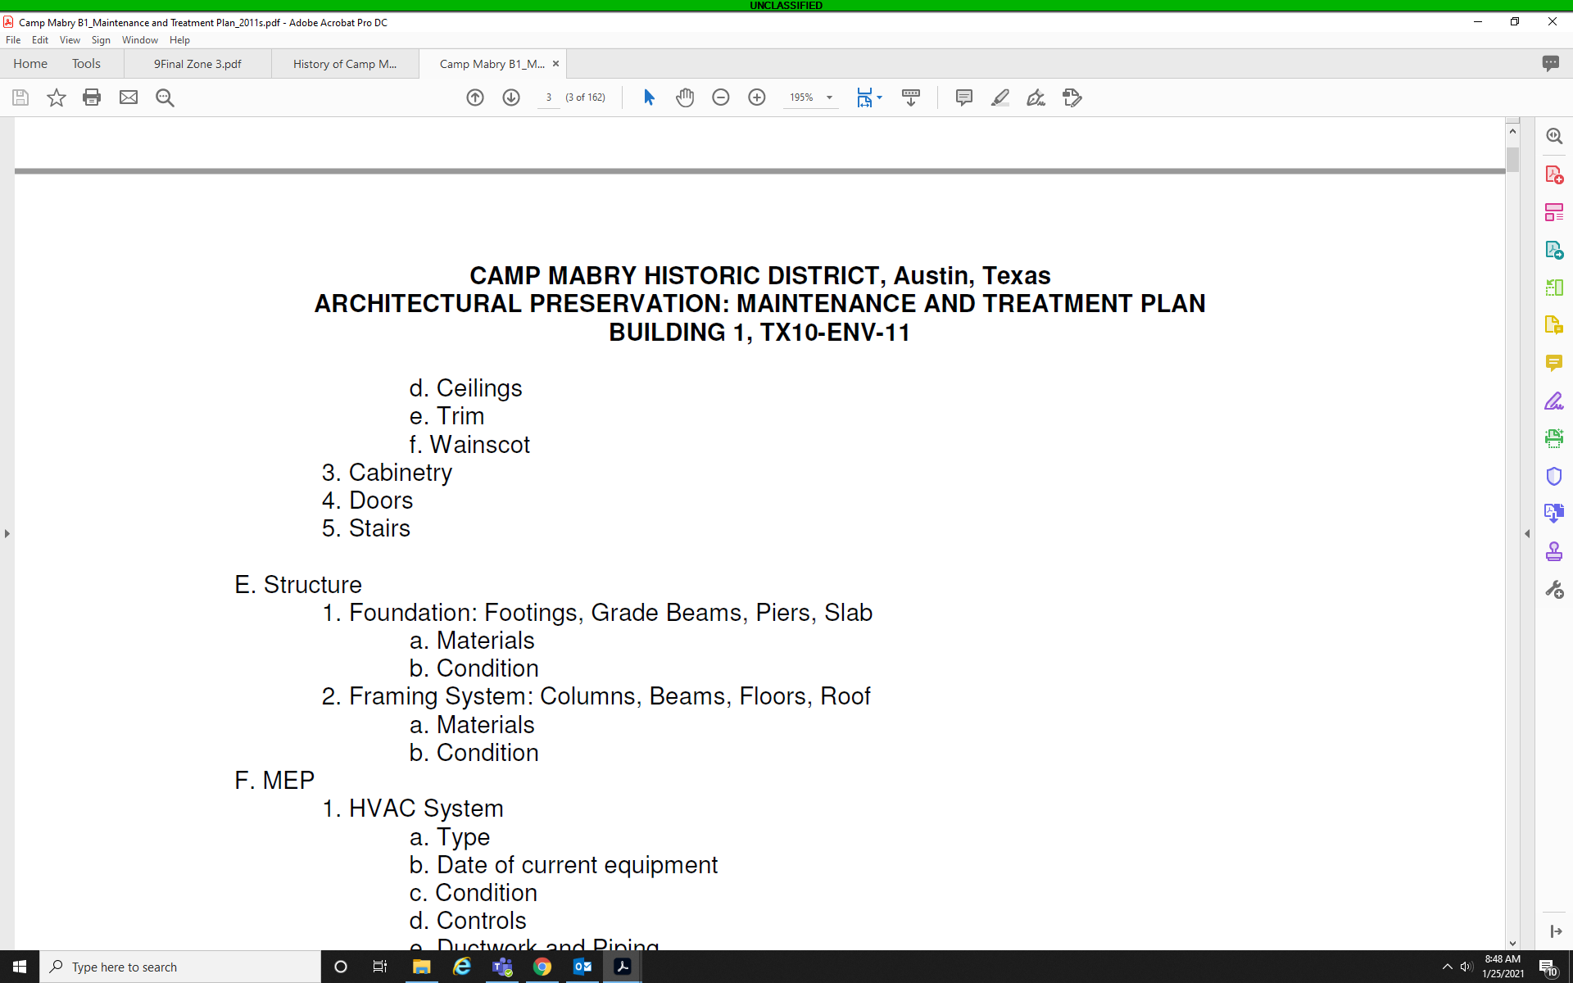
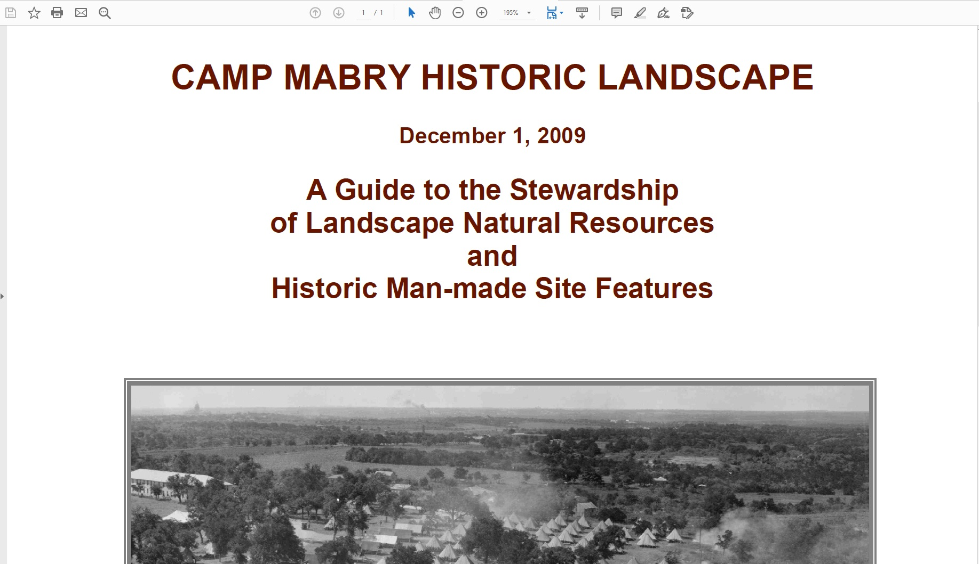
Case Study 3: Design Bid Build Camp Mabry Building 1
MAINTENANCE AND TREATMENT PLAN COMPONENTS
Identify intact historical elements
Provide a structural analysis
Provide a brief history of the modifications that have been made
List prioritized tasks for rehabilitation and maintenance to keep buildings from further decline.
Provide recommendations for energy efficient and LEED standard silver design solutions that maintain historic integrity.
Include cost estimates for tasks for current year and five years out.
Include estimates of lifespans of existing original materials.
Recommend a timeline for recurring tasks, including building inspections.
Develop a simple database to conduct in-house inspections to track building condition and energy efficiency measures.
Identify critical historic materials to be preserved and salvaged from buildings to reduce waste in landfill.
Notes:
Background on Maintenance and Treatment Plan
The TXARNG CRM recognized need for their historic products to be useful and relevant to the Mission. Therefore, when preparing Scopes of Work for Maintenance and Treatment Plans, the CRM submitted them to the CFMO team for their input and review. In the State contracting mechanism process used, a CFMO rep was also part of the Request for Proposal selection team. They also provided review and comments on drafts of the plan. This helped improve the quality of the document and also increased visibility and awareness of its existence within the CFMO office.
As can be seen, it was important for the document to provide a foundation of conditions, guidance and options for the CRM to share with decision makers as projects were developed. It is critical for CRMs to reach out and communicate with their colleagues about how their products can be helpful to them to maintain compliance with their projects.

Slide 22
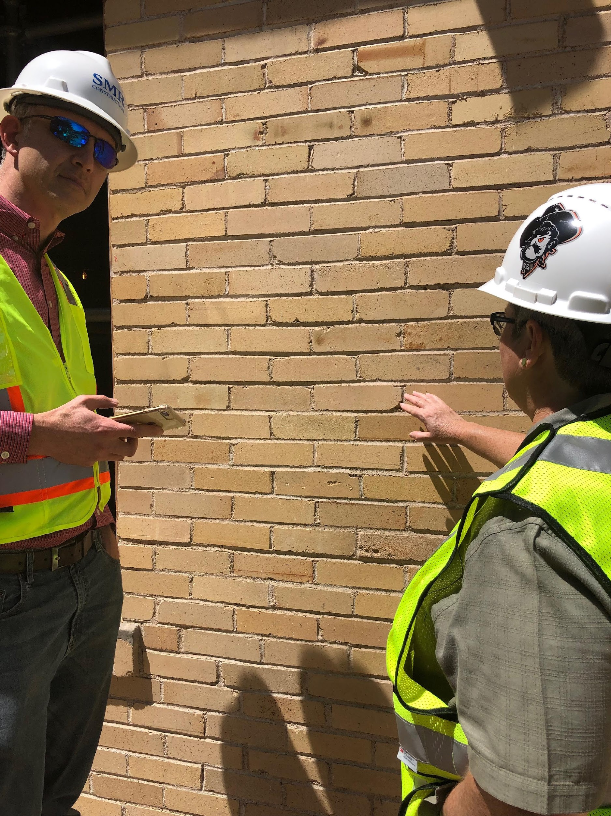
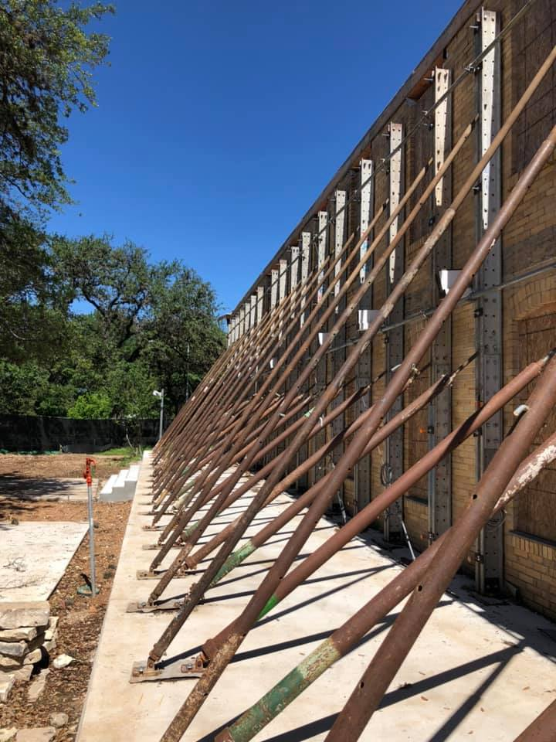
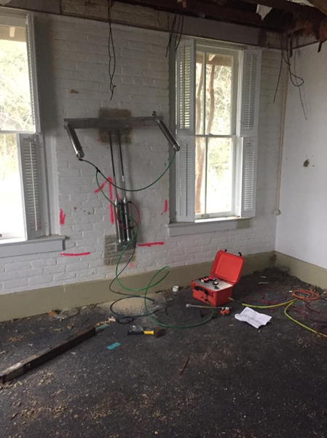
Case Study 3: Design Bid Build Camp Mabry Building 1
M&T Plan provided insight into structural issues.
Photos courtesy of Texas Army National Guard
Notes:
The project was challenging. The 2011 Maintenance and Treatment Plan had identified the need for a new foundation to be placed within the structure while maintaining the exterior walls. The interior of the building had been extensively remodeled several times so all historical significance was retained in the exterior walls, windows and doors.
Structural testing was done as can be seen in the center photo on the slide. With that information, a complex structural shoring plan had to be developed that took into consideration limiting penetrations to the historic masonry, with additional goal of primarily anchoring shoring into mortar rather than historic bricks. In the picture on the right, the CFMO project manager reviews the location of structural supports in mortar prior to their installation (left side of slide). The CRM team was on site to approve the mortar penetrations for the anchoring of the structural supports and documented where bricks could not be avoided.

Slide 23
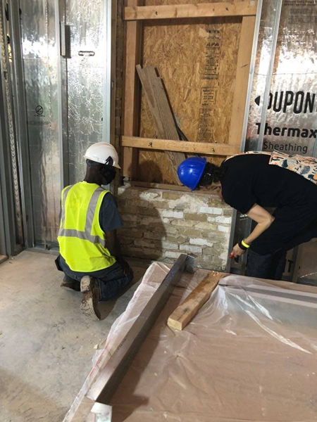
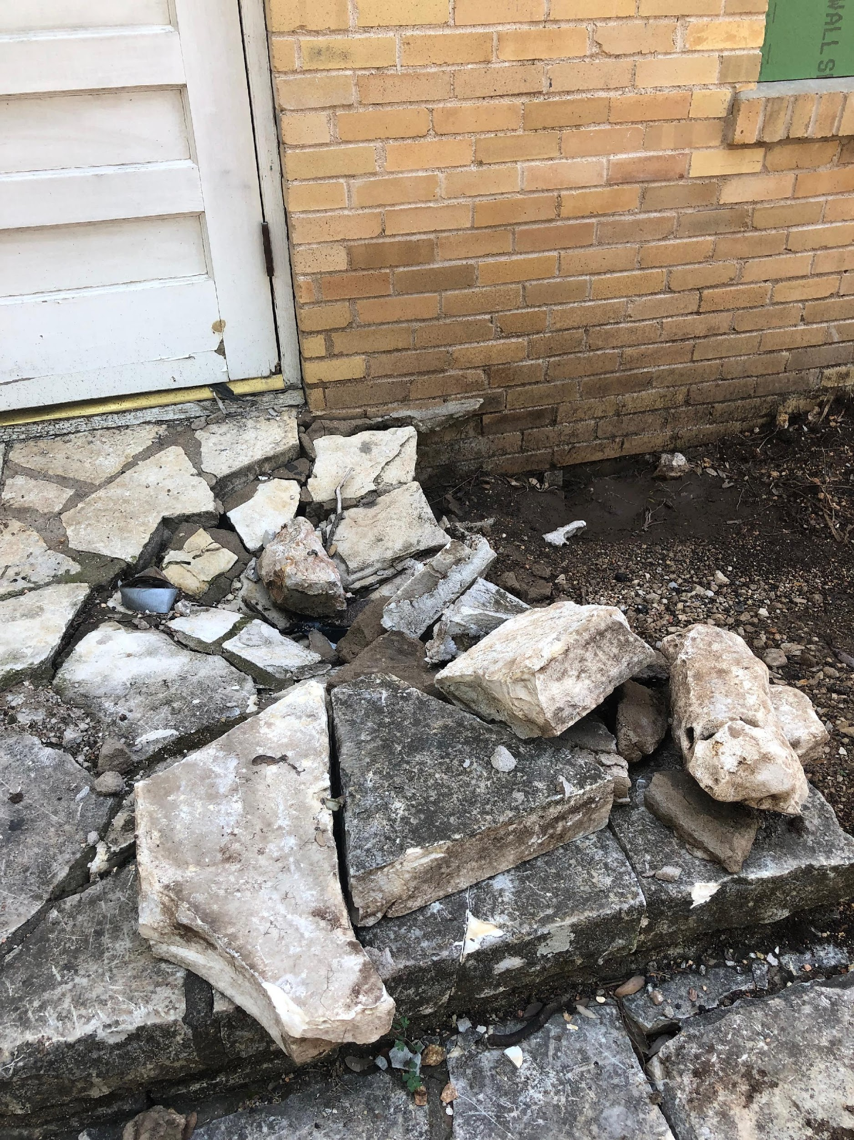
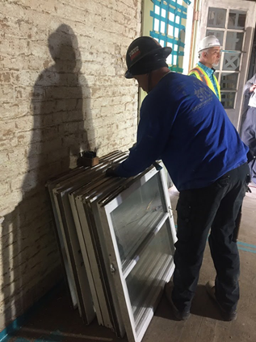
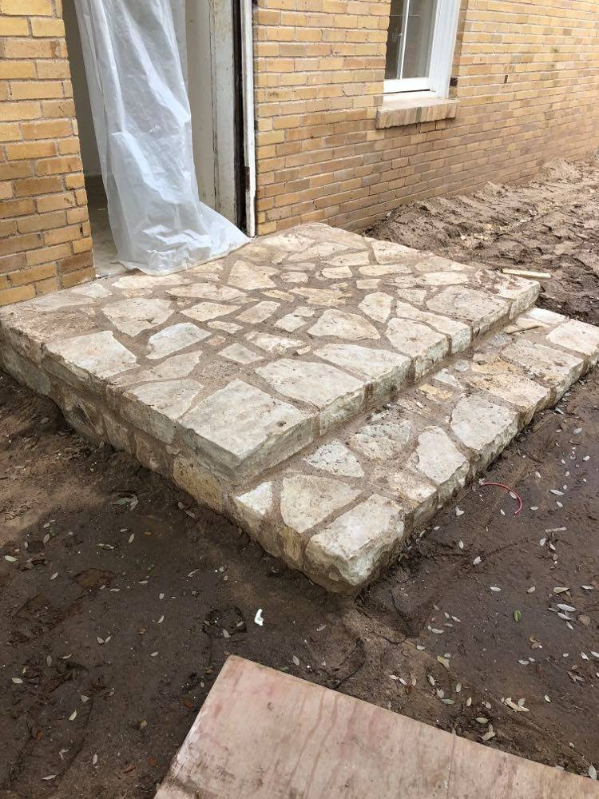
Case Study 3: Design Bid Build Camp Mabry Building 1
Historic Window removal
Left and Above: Historic Masonry at Building 1
Photos courtesy of Texas Army National Guard
Notes:
The CRM team also had responsibility to approve qualifications of sub-contractors, including the firm selected to complete historic window restoration (right hand side) and the firm completing masonry repairs (center and left). While not every organization may follow the same integrated approach, it is recommended for historic projects to include a qualified professional, whether from the installation/facility or a sub-contractor consultant, to follow project progress and ensure compliance conditions are being met.

Slide 24
Case Study 3: Design Bid Build Camp Mabry Building 1
The CRM active presence on team meant inadvertent discoveries and changes in treatment could be addressed quickly.
CFMO team became invested in historic process and pro-actively identified and addressed potential issues with contractor.
Photo courtesy of Texas Army National Guard
Notes:
With such a sensitive project, it might be tempting for the project manager to just gloss over changes in treatments to historic materials or decide it was not worth the time to notify the CRM about an inadvertent discovery of a historic feature during interior renovation. However, with the CRM on the team, actively participating in the progress meetings and responsive to requests to review work on site, the project manager and the contractor were not faced with roadblocks or stoppage to the project. The CRM’s engagement with team improved awareness and understanding of historic issues and led to more pro-active engagement from the team on meeting compliance requirements. In some cases, it helped present solutions that had not been considered, such as dealing with certain mortar and masonry issues at windows.
The Design Bid Build process advantage in this project is the active involvement of the entire Team throughout the course of the project. With the ability to address project issues as they arose via the DBB project team, the TXARNG moved forward on the project and were able to maintain control and input into adjustments to project.

Slide 25
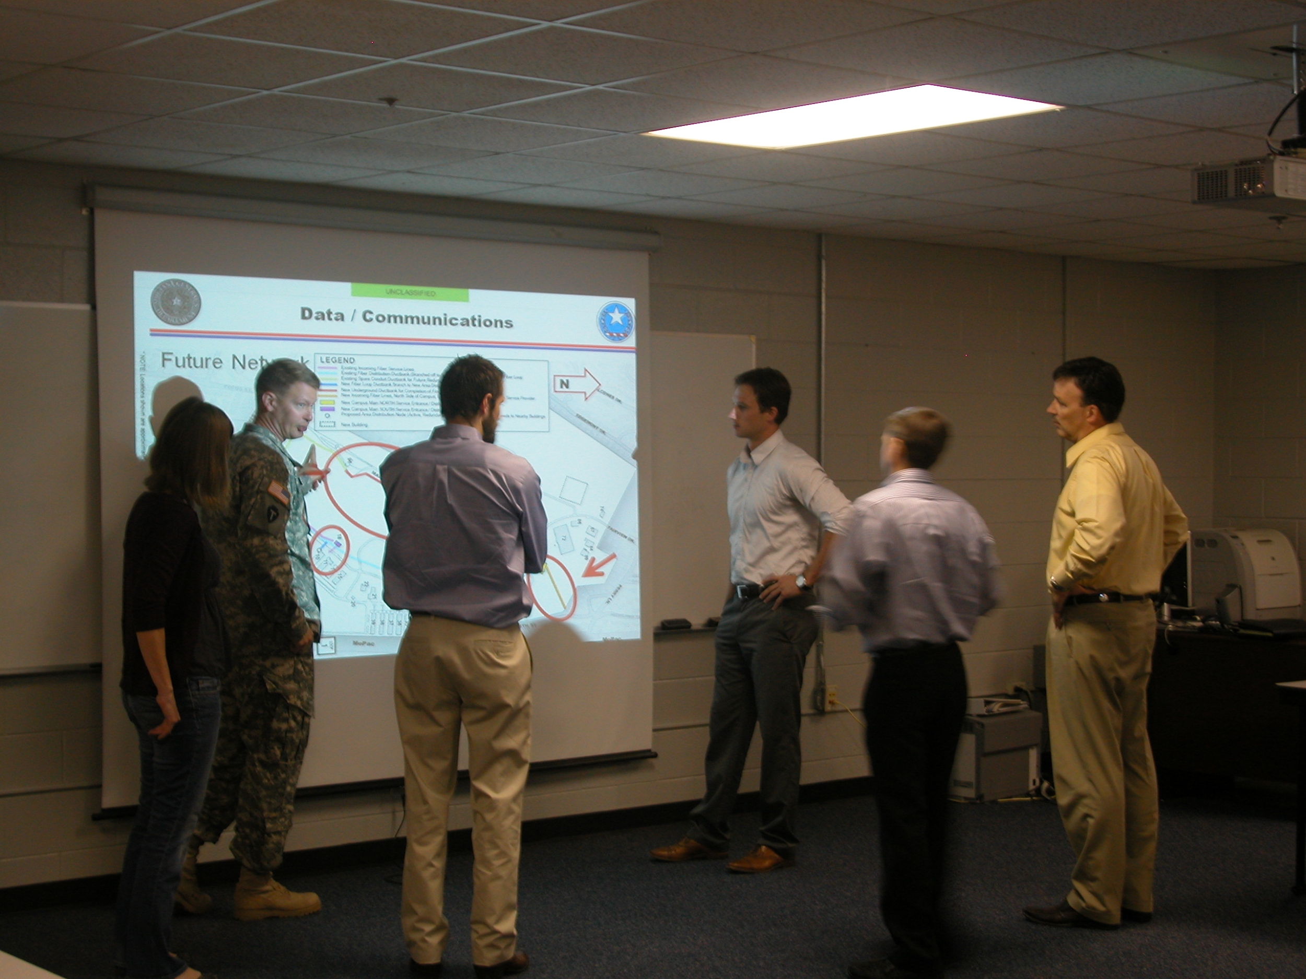
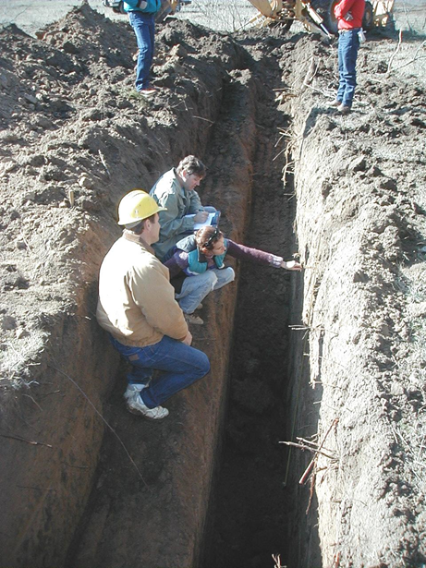
Enterprise Approach of Collaboration and Communication
Enterprise CRM:
  Embed early with the Master Planning Process
  Involve and Educate Facilities and Maintenance Staff in Historic Preservation processes, training, and program goals
  CRM role is to provide subject matter expertise to the project team to effectively comply with historic regulatory requirements without significantly impacting timelines, costs or mission readiness.
Photos courtesy of TMD (left pics) and Fort Hood (right pic)
Notes:
It is recommended for CRMs to identify their roles within an organizational structure and find the earliest potential opportunities to engage on potential cultural resource compliance issues, whether via Design Build (DB) or Design Bid Build (DBB). As one can see in the Fort Drum Airfield Barracks DB example, it is important to not stop project timelines but identify a solution that provides regulatory compliance with the least impact to project execution. Because the Fort Drum CRM worked proactively avoid delaying project for full archaeological inventory, the engineers and planners were receptive to shifting the footprint to locate in the area least likely to cause issues in coordination. Similarly in the Building 38 DB example, the rapid timeline for design could have resulted in the situation where final design would be submitted after most of the project had begun. However, the TXARNG team approached the SHPO to work out a solution that ensured regulatory compliance and adherence to preservation standards. Both projects are unique in avoiding the additional timelines and potential costs associated with negotiating an agreement document for mitigation of adverse effects. The Building 1 example, in contrast, as a DBB process demonstrated a fully integrated approach to projects. In this example, the CRM program’s product (Maintenance and Treatment Plan) provided a foundation to inform the major construction rehabilitation of Building 1. The CRM served as a member of the project team from the start to finish of rehabilitation, even serving as one of the final reviewers on the punch list to close out project successfully.

Slide 26
End Notes: Sharing Responsibility
CRM and Preservation Team
Planners, Project Managers, Maintenance, Contractors, Funding Team, Range Planners and Engineers, Soldiers and Tenants
Engage with the appropriate staff working on project, when appropriate.
Provide training internally or assist in sharing useful courses and information updates for non-CRMs and complete available training relevant to supporting mission activities.
Keep facilities databases updated with historic property information (GIS, ICRMP) but also keep it simple with handy lists or info sheets on historic buildings distributed to internal stakeholders.
Walk the halls or MS Teams groups. Introduce yourself, keep contact information visible and accept opportunities to join meetings and team discussions.
Engage early with the CRM (if present on installation) to help support mission operations effectively.
If there is CRM available training or guides, take opportunities to learn the historic properties and processes.
Check the installation historic categories codes in databases and/or consult your GIS or Cultural Resource data sets for information on historic status BEFORE beginning planning.
Walk the halls or send a message to the CRM.
Notes:
This webinar, intended for Cultural Resources and Construction Management personnel, does not draw any conclusions on which construction delivery method is “better” for preservation than the other, after all there is often no choice in the process delivery method applied. Rather, it is important is to understand the unique timelines, constraints, advantages and disadvantages of each process. CRMs need to be responsive and understanding of how those processes interact with cultural resource compliance. To mitigate preservation impacts of ANY type of construction or maintenance activity, there are a general set of recommendations presented here. Bear in mind that not every installation or service branch operates in the same manner, so it is critical to consult with the respective regulations for an installation, facility or regional/headquarters office.
Training and Awareness
Any opportunity for the CRM to create trainings or documents to increase awareness of regulatory compliance procedures is recommended. Simple self-directed trainings (like this slide deck) allow personnel to train on their own time if there are limited opportunities to present courses with instruction. CRM offices can create useful guidance documents on preservation to share with a variety of audiences. These trainings and documents can also increase visibility of the ICRMP and other CRM documents available, whether it be Maintenance and Treatment Plans, Preservation Design Guidelines or Historic Structures Reports. For protection of buried or submerged cultural resources, CRMs should provide guidance which protects sensitive site information while conveying the processes for avoidance and protection.
Communication and Interaction
CRM staff should visit with other branches and directorates as appropriate, to introduce themselves and become familiar with the processes and procedures impacting how regulatory coordination is conducted to improve efficiency. How are environmental reviews completed internally? Do those processes provide adequate time to incorporate cultural resource coordination, particularly for construction and maintenance of historic structures and facilities? Do Installation planning and programming staff have access to accurate data on cultural resources? How can that be shared and disseminated in a manner that protects sensitive information, such as locations of burials and archaeological sites?
Similarly, offices interacting with the CRM can encourage the CRM to become familiar with any of their own procedures and available trainings that might assist the CRM in supporting their activities. It is important for the CRM to understand the planning and programming cycle, basic rules of contracting and scoping, and other aspects of project management that are critical to mission success. If the non-CRM staff can become familiar with the CRM products available and procedures to follow, it will allow for adequate planning and project implementation, particularly in areas of cultural resource sensitivity.
Recently the DoD issued a guidebook on Cultural Resources Training and provided a memo encouraging implementation of Cultural Training across installations, beyond CRM offices to improve cultural resource stewardship. For more information on this guidebook, please see: https://www.denix.osd.mil/cr/planning/training/crtraining/dod-cultural-resources-training-overview-public-document-2022/DoD Cultural Resources Training Overview_Public_508.pdf

