Slide 1

Cultural Resource Training for the Non-CRM Professional
A Training Module for the Department of Defense (DoD)
Notes:
This training module was requested as a guide to individuals who may encounter cultural resources while conducting military operations. The importance of this training module lies in the guidance to 1) identify cultural resources that may be in danger of damage or disturbance and 2) establish a general protocol, in tandem with installation specific directions, to address discovery and impacts to cultural resources. This help guide is directed at the trainer, to provide useful tips in the emphasis of specific points to the trainee.
SLIDE 1 – Title Slide - Cultural Resource Training for the Non-CRM Professional

Slide 2
Cultural Resource Training Overview
Often the people whose decisions can affect cultural resources have limited experience in cultural resource management or archaeological site management.
Anyone can learn to be aware of cultural resources and how to avoid or mitigate potentially negative impacts.
This presentation was created to help explain to non-Cultural Resources Management (CRM) professionals:
what cultural resources are
how they are threatened
how they can be protected
Notes:
Slide 2 highlights the value of each individual’s efforts to recognize cultural resources, understand how seemingly routine actions can impact cultural resources, and how each individual can help protect cultural resources.
Key talking points from this slide are what the non-CRM professional needs to do if they encounter threatened cultural resources and how they need to protect these resources.

Slide 3
The DoD has a responsibility to protect cultural resources
The DoD has a large historic property portfolio, including “45 individual National Historic Landmarks, 3,032 National Historic Landmark contributing properties, 2,370 individual and contributing historic assets listed in the National Register of Historic Places, nearly 16,000 historic assets determined eligible for inclusion in the National Register of Historic Places, and over 134,000 recorded archaeological sites.”
The DoD also has leased properties and temporary locations that require the protection of cultural resources.
Notes:
Slide 3 creates a sense of how vast the DoD management area is and why it is so important that everyone do their part to help manage and protect these resources.
The quote above is from DoD Environment, Safety, and Occupational Health Network and Information Exchange (DENIX) Cultural Resources Homepage, which has these DoD statistics updated annually.
You can also add statistics for your installation(s) here.
The Department of Defense (DoD) is responsible for environmental restoration of properties that were formerly owned by, leased to or otherwise possessed by the United States and under the jurisdiction of the Secretary of Defense. Such properties are known as Formerly Used Defense Sites (FUDS). The Army is the executive agent for the program and the U.S. Army Corps of Engineers manages and directs the program's administration. The scope and magnitude of the FUDS program are significant, with more than 10,000 properties identified for potential inclusion in the program. http://www.usace.army.mil/missions/environmental/formerlyuseddefensesites.aspx
Key talking points from this slide are that the DoD’s land holdings are vast, and it is everyone’s responsibility to protect cultural resources.

Slide 4

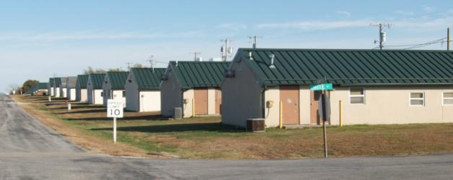
Leadership Focus
The Department of Defense (DoD) has responsibilities under a number of Federal, State, and Local laws to identify, evaluate, and protect Cultural Resources.
Cultural Resources located on each individual installation are the responsibility of that installation’s leadership and personnel to manage and protect.
An awareness of and respect for Cultural Resources needs to be promoted from the top down.
Resources available to leadership to help protect cultural resources include:
CRM/CRS (Cultural Resource Manager/Specialists)
ICRMP (Integrated Cultural Resource Management Plan)
Environmental Coordinator
Facilities Manager
Notes:
Slide 4 describes that legislative mandates require installations to protect cultural resources and are supported by leadership. Resources (documents) are available as well as support personnel (CRM specialists) to address cultural resource needs. The non-CRM professional should be encouraged to know the leadership who can support the efforts of cultural resource preservation. The photograph depicts an example of military barracks. [NOTE: Pictures can be replaced to reflect specific military installations]
Key talking points from this slide are that the DoD has an obligation to preserve publicly owned resources for now and for the future. It is the responsibility of all DoD employees to preserve their heritage.

Slide 5
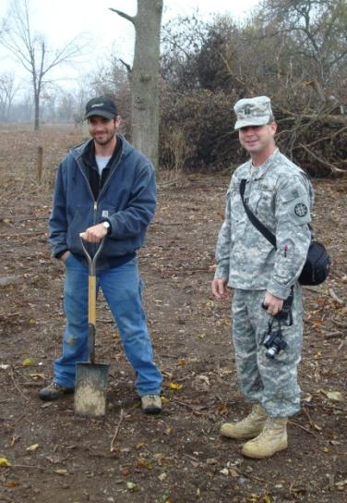
Service Member Focus
Develop an understanding of cultural resources.
Plan ahead to avoid and protect cultural resources.
Communicate proposed activities with installation CRM.
Learn about potential/possible inadvertent discoveries.
Know who to contact and what to do in case you have an inadvertent discovery.
Use available technology such as GPS/GIS and aerial photography.
Clearly communicate buffers and areas of avoidance with everyone accessing the project area.
Clearly mark buffers and areas of avoidance with flagging tape or some other highly visible means.
Be aware of potential threats to cultural resources.
Notes:
Slide 5 emphasizes what field personnel can and should do to avoid impacting and disturbing cultural resources. Planning ahead, communicating concerns to the appropriate individuals and understanding the location of cultural resources near a work area are critical. The photograph depicts installation personnel conducting an initial site survey in the field. [NOTE: Pictures can be replaced to reflect specific military installations]
Key talking points from this slide are that all service members of the DoD need to be aware of all the different resources at their disposal and that communication is key to success.

Slide 6
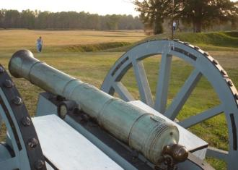
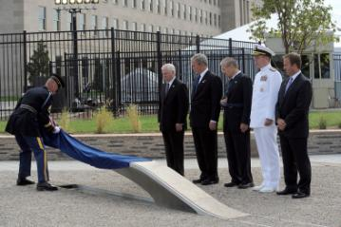
Desired Outcome of Cultural Resource Training?
Create an Awareness of:
  Recognizing what cultural resources are and understanding them as non-renewable assets - once destroyed they are lost forever.
  Learning to plan ahead with regards to cultural resources – ensuring compliance with all Federal and state guidelines and requirements to avoid and protect cultural resources.
Understanding that DoD property is publicly owned land and we, as the land managers, must be good stewards – protecting cultural resources for future generations.
Notes:
Slide 6 underscores the value of cultural resources as a non-renewable resource that cannot be replaced. The slide emphasizes planning to avoid destruction of cultural resources in the field and the responsibility of DoD installations to be good stewards of the land, balancing mission objectives with protection of cultural resources. The photographs depicted (from top to bottom, clockwise) are as follows: M1857 12-Pounder “Napoleon”, Pentagon Memorial Dedication Ceremony. [NOTE: Pictures can be replaced to reflect specific military installations]
Key talking points from this slide are to recognize what cultural resources are, learn how to protect cultural resources and understanding each individual's responsibility in protect non-renewable resources.

Slide 7
What Are Cultural Resources?
Cultural Resources Examples
Archaeology
Landscapes
Traditional Cultural Properties
Folklore
Shipwrecks
Objects (i.e., Artifacts)
Cemeteries & Burials
Caves
Buildings
Structures
Monuments
Battlefields
As defined in the 1966 National Historic Preservation Act, a historic property is “any prehistoric or historic district, site, building, structure, or object included on, or eligible for inclusion on, the National Register, including artifacts, records, and material remains relating to the district, site, building, structure, or object.” (NHPA) [54 U.S.C. § 300308]
Notes:
The following slides can be customized for your installation to indicate the types of sites that are known or may be encountered.
Slide 7 describes what cultural resources are. Cultural Resources are defined by the 1966 National Historic Preservation Act but the qualifying characteristics are determined and evaluated by trained professionals, the general public, and to some extent by current events.
Key talking points from this slide are cultural resources can be many things and can vary depending on the base location and region.

Slide 8
What is CRM?
Cultural Resource Management (CRM) is a practice devoted towards the protection and management of cultural resources. The management of cultural properties requires an understanding of the historic value of the resource, and how Federal actions may have an impact on cultural resources. This process is mandated by Federal and state legislation.
Each DoD property should have a Cultural Resource Manager, Environmental Coordinator, or Facility Manager. This contact may not be on site, but the installation commander should know how to contact them.
Notes:
Slide 8 touches on the definition of cultural resource management and their responsibility to the installation.
NOTE: Identify the title and or the person who is in charge of Cultural Resource Management at your installation.
Key talking points from this slide are that it is important to get to know your CRM and to maintain open lines of communication.

Slide 9
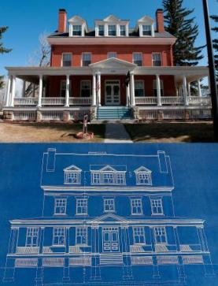
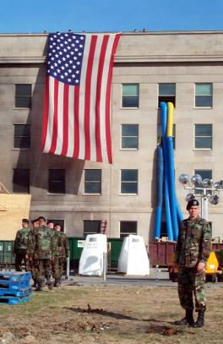
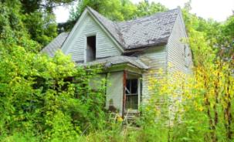

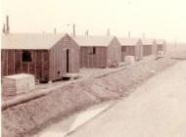
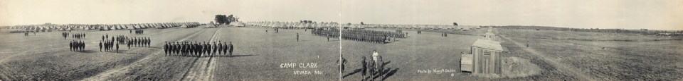
Buildings and Structures
Historic Districts and Landscapes
Notes:
Slide 9 showcases the concept that historic buildings such as the Pentagon and the White House are obvious significant cultural resources. However, historic farmsteads, bridges, and even simple WWII barracks buildings can serve as cultural resources or tangible connections to our past. Historic districts and landscapes such as the United States Army West Point campus, or the cantonment area of a small training camp, or even a series of walls and guard towers can be cultural resources. Respect all buildings and ruins you encounter because the cultural significance may not be readily apparent.
The photographs depicted (from top to bottom, clockwise) are as follows: Historic homestead, historic residence and blueprints, lowering the flag at the Pentagon, example of military barracks, Camp Clark parade ground. [NOTE: Pictures can be replaced to reflect specific military installations].
Key talking points from this slide are can anyone think of an example of a historic building, structure or historic district on their installation?

Slide 10
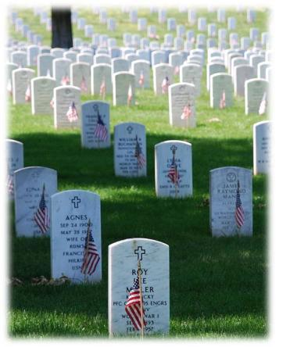
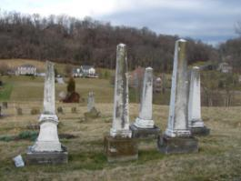
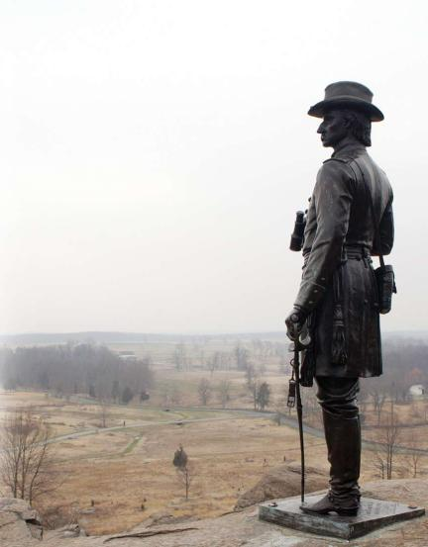
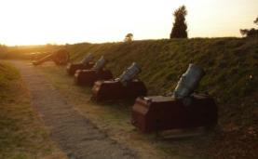
Cemeteries
Battlefields
Notes:
Slide 10 Cemeteries or places of burial whether they are marked or not are always considered a cultural resource that should be respected and left undisturbed when possible. If you encounter a headstone or bones eroding from the soil these locations should be noted and reported. Battlefields, particularly locations were significant loss of life occurred are often considered a cultural resource and some have become part of the United States National Park system.
The photographs depicted (from top to bottom, clockwise) are as follows: rural family cemetery, Arlington National Cemetery, Statue of Union Brig. Gen. Warren surveying the terrain within Gettysburg National Military Park, cannon, mortars, and earthworks located near Jamestown, VA . [NOTE: Pictures can be replaced to reflect specific military installations].
Key talking points from this slide are there any known cemeteries on your installation? What about any battlefields?

Slide 11
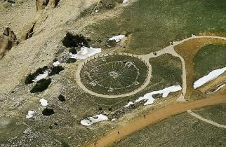

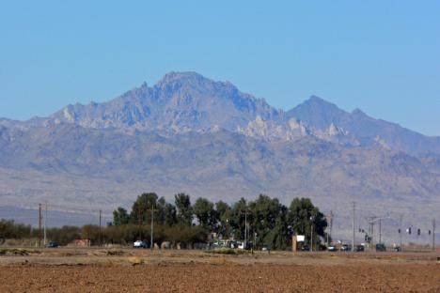
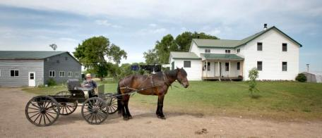
Sacred sites and Traditional Cultural Properties
Sacred site - any discretely delineated location on Federal land identified by an appropriately authoritative Native American tribe/representative, as sacred by virtue of its established religious significance to, or ceremonial use by a Native American religion.
Traditional Cultural Properties (TCPs) - include built or natural locations, areas, or features considered sacred or culturally significant by a group or people. While TCPs are closely associated with Native American Cultures, a site need not be associated with a Native American cultural group to qualify as a TCP.
Notes:
Slide 11 Special types of cultural resources are Sacred sites or Traditional Cultural Properties. These cultural resources may be elements of a landscape or special location. Examples are Ground Zero of the 9/11 disaster in New York or a mountain holding special symbolic significance associated with a Tribal origin described in their oral history. The photographs depicted (from top to bottom, clockwise) are as follows: Medicine Wheel TCP in Wyoming, instructional booklet on TCPs, rural Amish farm, Spirit Mountain as seen from Route 95 in Nevada . [NOTE: Pictures can be replaced to reflect specific military installations].
Key talking points from this slide are there any known Traditional Cultural Properties or Sacred sites on your installation? Has consultation been initiated with Native American tribes to determine if any TCPs exist?

Slide 12
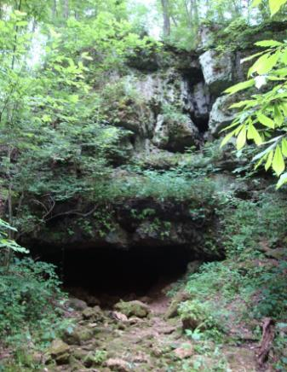
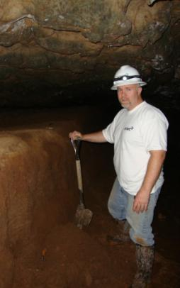
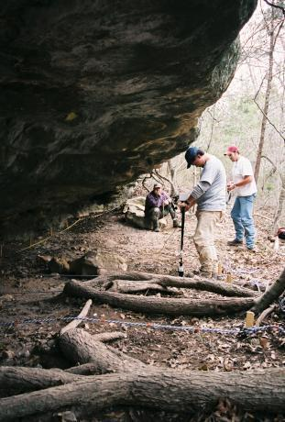
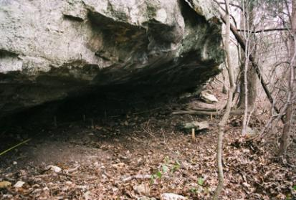
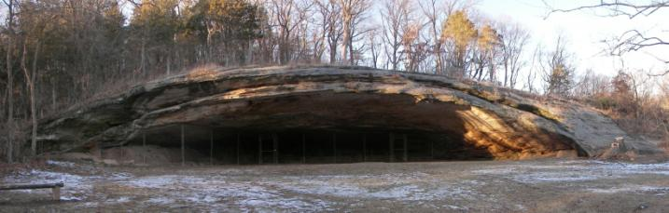
Caves and
Rock Shelters
Notes:
Slide 12 Caves and rock shelters often have significant cultural associations. Caves and rock shelters have been used for habitation; burial, storage, and ceremonial and spiritual purposes. The photographs depicted (from top to bottom, clockwise) are as follows: geophysical survey of a rock shelter in Texas, a cave entrance in Missouri, archaeologist looking at soil deposition in a cave, rock shelter in Texas, gated entrance to Graham Cave. [NOTE: Pictures can be replaced to reflect specific military installations].
Key talking points from this slide are there any known caves or rock shelters on your installation?

Slide 13
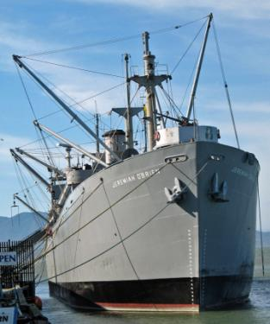
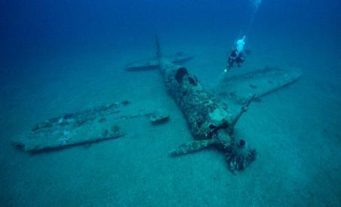
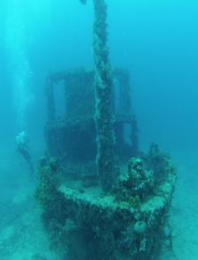

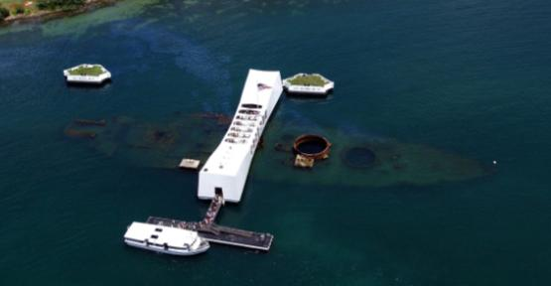
Underwater and Maritime Resources
Notes:
Slide 13 Cultural resources may be shipwrecks or submerged archaeological sites or buildings. The photographs depicted (from top to bottom, clockwise) are as follows: wreckage of single engine WWII airplane, SS Jeremiah O'Brien (one of two remaining fully functional Liberty ships of the 2,710 built and launched during World War II), USS Arizona Memorial at Pearl Harbor, maritime archaeologist, submerged tugboat. [NOTE: Pictures can be replaced to reflect specific military installations].
World War II Plane, Photograph by David Doubilet, National Geographic, A diver explores the wreckage of a Japanese World War II fighter plane near the town of Rabaul in Papua New Guinea. The waters around Rabaul, which was a Japanese stronghold during the war, are strewn with the broken remains of both Allied and Axis warships and aircraft.
Key talking points from this slide are there any known submerged shipwrecks or sites on your installation?

Slide 14
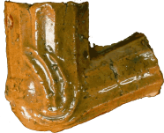
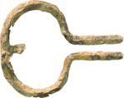
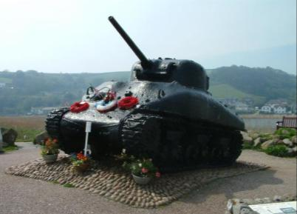
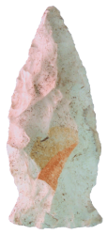
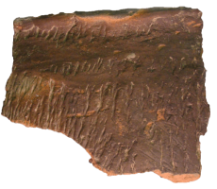
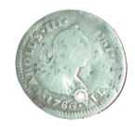
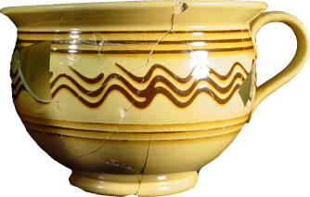
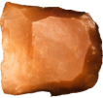
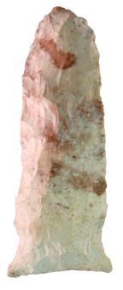
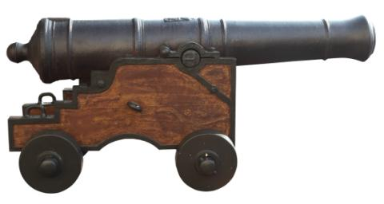
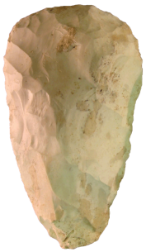
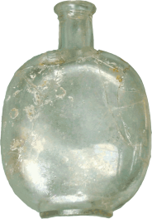
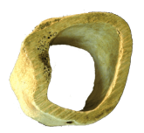
Objects and Artifacts
Notes:
Tank Memorial. At Torcross, Devon, England. This Sherman tank, raised from the seabed in 1984, acts as a memorial to the American servicemen who died here during E boat attacks while practicing beach landings in preparation for D-Day.
Slide 14 Any objects made or modified by humans from stone tools to WWII tanks are considered cultural resources. The photographs depicted (from top to bottom, clockwise) are as follows: projectile point, prehistoric pottery, pipe bowl, tank, jaw harp, yellowware bowl, biface, projectile point, bottle, butchered bone, cannon, 1786 Spanish Reale, scraper. [NOTE: Pictures can be replaced to reflect specific objects artifacts at military installations].
Key talking points from this slide are that the non-CRM professional could encounter many different historic artifacts on their DoD installation.

Slide 15
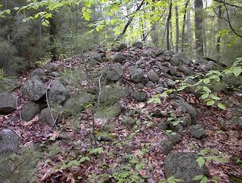
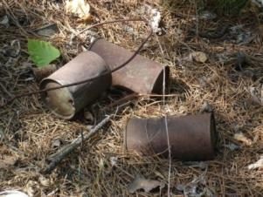
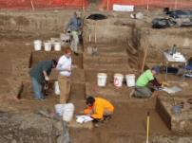
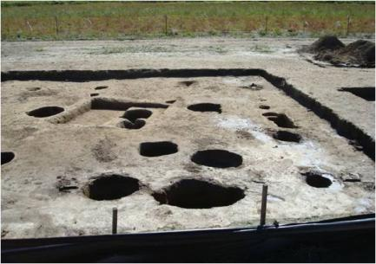
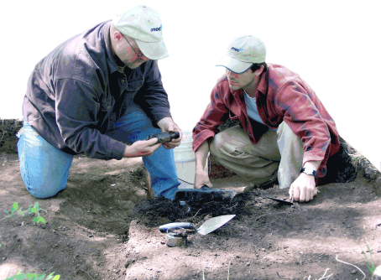
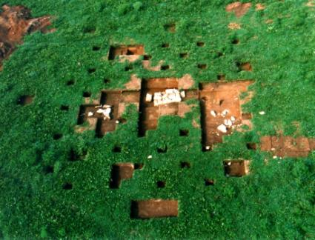
Archaeological Sites
Notes:
An archaeological site, be it prehistoric or historic, is a place or places where remnants of a past culture survive in a physical context that allows for the interpretation of these remains. It is this physical evidence of the past and its patterning that is the archaeologist’s database.
Slide 15 Archaeological sites are areas where humans have left behind a modified landscape and or artifacts. The photographs depicted (from top to bottom, clockwise) are as follows: historic can scatter from historic logging camp in Minnesota, the completed excavations of prehistoric pit features at an archaeological site in the Mississippi River floodplain, a rock cairn or rock mound, post-excavation of a 1920s home with a stone chimney pad, archaeologists excavating a feature at a WWII POW camp in Missouri. [NOTE: Pictures can be replaced to reflect specific military installations].
Key talking points from this slide are there any known prehistoric sites on your installation?

Slide 16
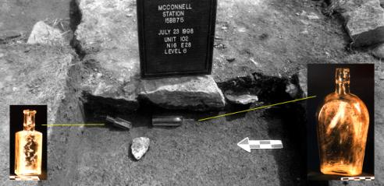
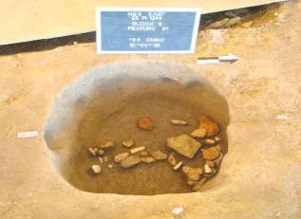
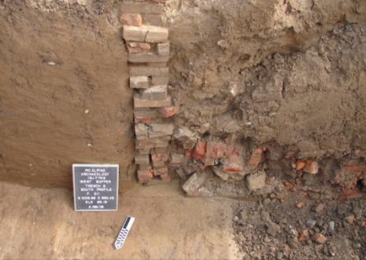
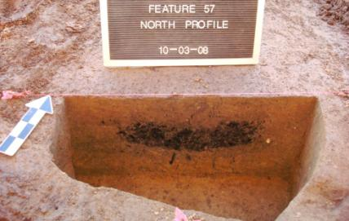
Archaeological Features
Historic features
Prehistoric features
Notes:
Features are defined as non-portable evidence of past human behavior, activity, and technology.
Prehistoric features commonly encountered might include soil anomalies like fire pits and hearths, burned earth and clay, trash and garbage pits, postholes, evidence of house floors or basins, storage pits, clusters of artifacts (e.g., chipped and broken stones, caches of projectile points, ceramics or pottery sherds), human and animal burials, clusters of animal bone, and earthworks (such as mounds and circular enclosures), petroglyphs and pictographs, and middens (cultural refuse buildup).
Historic features may include fire pits, ash and charcoal lenses and stains (i.e., brick flumes), trash and garbage pits and dumps, middens, postholes, house foundations and other structural remains (e.g., wells, cisterns, fencelines, ditches, canals, landscapes, embankments, mill races, dams, old trails and roads), cemeteries, human burials, and clusters of historic artifacts.
Slide 16 This slide shows archaeological features of Native Americans, historic settlers, and architecture. The trainee is not expected to be able to identify cultural resources in the field, but should be aware that discolored soil, structural remains like brick and cut foundation stone, or bits and pieces of stone representing the manufacture of stone projectile points may be very important. When items such as this are encountered in the field, a cultural resource specialist should be contacted to decide on a course of action to ensure the possible cultural resources are protected. The photographs depicted (from top to bottom, clockwise) are as follows: prehistoric pit feature with artifacts left in situ, two late 1800s bottles discovered in the builder’s trench of a stone chimney pad, the edge of a brick lined privy, a prehistoric feature in the profile. [NOTE: Pictures can be replaced to reflect specific military installations].
Key talking points from this slide is has anyone ever observed anything like this while working on base? If so, what did you do?

Slide 17
Cultural Resources Are Important
Culturally significant buildings, landscapes, objects, and documents are the embodiment of shared historical experiences. They are the tangible evidence of national memory and the history we share. According to the Department of Defense, “Recognizing and preserving such resources is one way in which society can impart its culture to future generations.”
(Legacy Resource Management Program 1994)
Notes:
Note: Ask the group if they can think of any cultural resources that they think are significant?
National Historic Sites, Museums, Military History, National Cemeteries, Battlefields, the White House, Capitol Hill, Pentagon…
Ask why these places or objects are important? Shared history, sources of pride, sense of nationalism, honor, remembrance…
Slide 17 describes the value of cultural resources to the DoD. This slide explains the benefit and importance of preserving our Nation’s heritage.
Key talking points from this slide are that cultural resources can and should be preserved for now and for the future.

Slide 18
Threats to Cultural Resources
Cultural Resources can be lost to development, forces of nature, looting*, and other natural and human factors including the military development and military training.
*Violations under the Archaeology Resources Protection Act, such as looting from archaeology sites on federal lands, can lead to fines and jail time.
Notes:
Now we have an understanding of what cultural resources are, let’s discuss how they are threatened.
Can you think of any types of development or training that might impact cultural resources?
Digging latrines, ditches, foundations, utility trenches, fox holes…
Grading a road, off road vehicles…
Slide 18 A variety of actions may damage cultural resources. If proper planning and protocols are established, damage to cultural resources can be avoided. All actions listed can pose threats to cultural resources. Critical to protecting cultural resources is proper preparation with a background understanding, identifying potential for cultural resources, being observant as the work is ongoing to the potential for inadvertent discoveries, and knowing the protocol if cultural resources are being damaged.
Key talking points from this slide it is important to understand that many activities or natural occurrences can damage cultural resources. Be prepared at all times to what you are doing and how you can prevent destruction or loss to our Nation’s heritage.

Slide 19
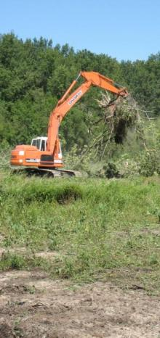
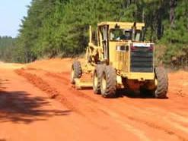


Threats to Cultural Resources
Threats to Cultural Resources may include Natural Resources management activities, as well as training and routine operational and maintenance activities:
Combat Operations
Training
Erosion
Illegal collection of artifacts
Vandalism
Decay
Neglect
Controlled Burn / Fire breaks
Plowing
Propeller Wash
Demolition
Encroachment
Hazard Waste/Hazardous Spills
Notes:
Slide 19 A variety of actions may damage cultural resources. The photographs depicted (from top to bottom, clockwise) are as follows: road grader creating a firebreak, excavator cutting brush, an example of graffiti vandalism, Soldiers conducting training maneuvers. [NOTE: Pictures can be replaced to reflect specific military installations].
Key talking point from this slide is that there are man-made and natural threats that could damage or destroy an archaeological site.

Slide 20




Threats to Cultural Resources (cont.)
Tracked and wheeled vehicle maneuvering;
Artillery impact and live-firing of weapons;
Facility construction;
Right-of-way easements;
Construction of pedestrian trails;
Construction of a modern structure or feature within the viewshed of an historic property or district;
Construction of new roads (dirt or paved);
Construction of fire breaks in new areas which involve earthmoving activities;
Ground disturbance located on known archaeological sites;
Forest management (i.e., timber harvesting, tree planting, prescribed burning);
Erosion control measures that alter original ground surface;
Remediation activities that involve building demolition and earth excavation to remove contaminants;
Other earthmoving activities (i.e., terrain modification);
Plowing and disking in historically agricultural areas; and
Repair, alteration, modification, demolition, or disposal of standing structures – including bridges – over 45 years of age.
Notes:
Slide 20 A variety of actions may damage cultural resources. The photographs depicted (from top to bottom, clockwise) are as follows: excavators engaged in demolition activities, historic pedestrian trail eroded from flooding, field maintenance training area, wild land fire management. [NOTE: Pictures can be replaced to reflect specific military installations].
Key talking points from this slide is that all individuals must be prepared and be informed of what activities on base could adversely affect cultural resources on their installation so good communication within each organization is essential.

Slide 21
Archaeological Sites and Historic Buildings
Some of the most common cultural resources on DoD properties are Archaeological Sites and Historic Buildings.
Notes:
Slide 21 What follows on the upcoming slides are examples of different types of archaeological sites that could be found on military installations.
Key talking points from this slide are does the non-CRM professional know of any archaeological sites or historic structures on their installation?

Slide 22






Archaeological Sites can be almost anywhere…
Historic foundations under the street in a utility trench.
Rock chimney base in wooded area.
Prehistoric feature eroding from the river bank (bottom) & the wall of a backhoe trench (top).
Historic house foundations buried in open grassy area.
Archaeological site between the sidewalk and the street.
Notes:
Archaeological sites are surprisingly common on the landscape and come in a variety of types and sizes. Archaeological sites on this installation range from large, prominent prehistoric mounds, historic forts and plantations, to smaller sites, such as a historic dump or small scatters of artifacts that represent temporary encampments of Native American people. Regardless, all archaeological sites have the potential to tell us something about people and environments of the past.
Slide 22 There are times where it is not so obvious where an archaeological site can be found. That is why it is so important to talk with your CRM about where military operations will occur and ask if the area is clear of all cultural resources. The photographs depicted (from top to bottom, clockwise) are as follows: rock chimney base in wooded area, historic foundation under the street in a utility trench, historic house foundation buried in an open grassy area, archaeological site found between the sidewalk and the street. [NOTE: Pictures can be replaced to reflect specific military installations].
Key talking points from this slide is that all non-CRM professionals must be prepared and be informed of what activities on base could adversely affect cultural resources on their installation so good communication within each organization is essential. .

Slide 23





Historic Buildings …
Contact the installation CRM for any actions that may change or modify a historic structure. This could include demolition, building an addition, constructing a new building, renovations, replacing a roof, flooring, windows, doors, exterior cladding, paint colors, or trim.
Ask if there is a maintenance and treatment plan for this building or installation?
Historic structures can include
water towers, bridges, ranges,
latrines, storage sheds,
training equipment,
training areas, etc…
Notes:
Petty Officer 3rd Class Woodman Fleurizard and Petty Officer 3rd Class Shavonnah Magee, both assigned to Naval Mobile Construction Battalion 74 Detail Horn of Africa, apply stucco at a primary school project in Djibouti on Dec. 12, 2010. Naval Mobile Construction Battalion 74 is assisting Combined Joint Task Force Horn of Africa in building partner nation capacity and promoting regional stability. DoD photo by Petty Officer 2nd Class Michael Lindsey, U.S. Navy.
Old range targets at Camp Clark, Missouri.
Pentagon
Slide 23 Many buildings on a military installation are recorded as historic structures. Alterations to these buildings could damage these historic resources. The photographs depicted (from top to bottom, clockwise) are as follows: petty officers applying stucco to building, Cadet Chapel at the US Military Academy at West Point, NY, Soldiers march through the castle entrance in Buedingen, Germany, Pentagon, old range targets at Camp Clark, Missouri. [NOTE: Pictures can be replaced to reflect specific military installations].
Key talking points from this slide is that any building or structure could be important and before any work is started on a building, non-CRM professionals should check with their CRM to see if the building has been recorded as a historic resource.

Slide 24



Historic Buildings …
DoD is responsible for environmental restoration of heritage properties that were formerly owned by, leased to or otherwise possessed by the United States, at home and overseas.
Members of the Mongolian Armed Forces 338 Construction & Engineering Unit and Mongolian contractors install a new window during renovation work on the Erdmiin Oyun School July 25, 2013, in Ulaanbaatar, Mongolia
The Navy renovated the historic Hotel Del Monte, a campus of the Naval Postgraduate School, while updating it to meet national defense needs.
Notes:
Historic Hotel Complex Updated to Meet National Defense Needs - https://www.achp.gov/sites/default/files/2018-07/Monterey.pdf
Members of the Mongolian Armed Forces 338 Construction & Engineering Unit and Mongolian contractors install a new window during renovation work on the Erdmiin Oyun School July 25, 2013, in Ulaanbaatar, Mongolia, as part of exercise Khaan Quest 2013. Khaan Quest is an annual multinational exercise sponsored by the U.S. and Mongolia, and it is designed to strengthen the capabilities of U.S., Mongolian and other nation’s forces in international peace support operations.
Slide 24 describes the DoD’s role in re-using resources on military installations. These modifications should only be completed after discussions have taken place between the department requesting modifications and the installation’s CRM. The photographs depicted (from top to bottom, clockwise) are as follows: environmental restoration of DoD property, installation of a new window during renovation work on the Erdmiin Oyun School in Ulaanbaatar, Mongolia, re-use of a historic building at Fort Snelling for homeless veterans. [NOTE: Pictures can be replaced to reflect specific military installations].
Key talking points from this slide is that communication between non-CRM professionals and the base CRM should be occurring prior to any work being performed on a historic building so that damage does not take place to that historic resource.

Slide 25






Historic Buildings…
Historic elements of buildings being demolished can be salvaged to maintain buildings that are being restored or reused.
Notes:
This historic mess hall at Camp Clark in Nevada, Missouri, USA was built prior to WWI and was used as a mess hall, barracks, office space, and storage space since then. Some of these renovated buildings renovated were reused as barracks and office/classroom space and one of these buildings was slated for restoration and use as an interpretive/history center for the installation. This involved historic research, studying historic plans and photographs to determine the original elements and the creation of a plan to salvage and recreate missing or damaged elements.
The images on this slide are of the same historic mess hall building type built at Camp Clark in Nevada, Missouri. Top left shows the modern renovation, left center shows the not updated condition, bottom left shows the mess hall when it was relatively new, top right shows salvaged components, windows, doors, screens, timbers, tile blocks etc from buildings that were demolished. These were used to maintain the historic integrity of several of the remaining buildings. Bottom right shows the original plans for this building. Center shows this building type being reused as office space during WWII.
Slide 25 describes what can be done with a historic building once the determination has been made that the best course of action is to demolish the building. Salvage as much of the structure as possible since it is likely that there are other buildings on base that are similar, and the salvaged material could be used to restore other buildings. The photographs depicted (from top to bottom, clockwise) are as follows: various pictures of the mess hall at Camp Clark in Nevada Missouri. Construction drawings and photographs of the construction through the re-use of the building as a barracks and finally as it was demolished but portions of the building was salvaged for use on other buildings. [NOTE: Pictures can be replaced to reflect specific military installations].
Key talking points from this slide is that even though a building was used for a specific task when constructed, its use can change over time and can still be used once the life of the building has run its course.

Slide 26




Threats to Cultural Resources – What To Do?
SURVEY
TESTING
Key Points
  Be prepared by:
  Planning ahead and discussing your project with the CRM and Master Planner.
  Having a cultural resources survey conducted as part of initial planning stages.
  Taking steps to mitigate potential damage.
  Monitor projects that have the potential to impact cultural resources.
  Know the Best Management Practices (BMPs) or Standard Operating Procedures (SOPs) for your location.
  Have a preservation plan and agreement documents.
MONITORING
MITIGATION
Notes:
Prior to any activities being conducted on a DoD installation it is likely that a cultural resources survey has taken place. Archaeologists study old maps and documents, and then survey the ground. If archaeological sites are identified they are evaluated by further testing to determine if the sites are significant enough to warrant protection and management. If cultural sites are located in an area where potential impacts such as construction or digging a utility trench can be monitored by CRM professionals or the site may need to be excavated by professionals, recorded and therefore fully removed from threat which is a common form of mitigating the threat of impact or mitigation. Historic buildings undergo similar types of survey, recording, and the maintenance and treatment plans are sometimes developed to avoid harmful impacts during maintenance and renovations.
Archaeologists excavate sites carefully to maintain the original context or associations of the artifacts being recovered. When artifacts are from are mixed together, it is difficult or impossible to recreate what happened at the site. This simple fact leads to the most basic principle of archaeological site management. Things should remain in their original location or context. When the artifacts and surrounding material are disturbed, archaeological information is destroyed. An artifact might be aesthetic in its own right, but its greatest value—the information about its user that was learned from its context—will be lost if it is removed from its original context. The large part of site management is simple to express, but difficult to achieve—prevent change.
Slide 26 describes how to make non-CRM professionals aware of what resources are located on their base. CRM’s have a great deal of information available to them and they can make this information is available to non-CRM professionals. The photographs depicted (from top to bottom, clockwise) are as follows: survey, testing, mitigation, monitoring. [NOTE: Pictures can be replaced to reflect specific military installations].
Key talking points from this slide is that the CRM and the non-CRM professionals must be prepared by taking steps to mitigate potential damage, provide better response and recovery from disasters be they natural or manmade, and have a preservation plan and agreement documents in place. They should be working together to avoid damage or destruction to cultural resources.

Slide 27
Find out from the Installation CRM what the Standard Operating Procedures (SOPs) are for any Installation you may be working or training.
Standard Operating Procedures (SOPs) are actions that are considered effective and appropriate. They represent the general knowledge and practice of informed professionals.
Notes:
Slide 27 describes how important it is to stay in touch with the base CRM and know what should and should not be done that could damage or destroy cultural resources.
A key talking point from this slide is that the non-CRM professional must be talking to the installation’s CRM early and often.

Slide 28

Does the installation have any Sacred sites or Traditional Cultural Properties?
Planning Phase – Plan Ahead
How do I Contact the CRM?
Prior to commencing a project, training activity, maintenance task, or program, it is crucial to understand what information already exists about the area, resources, surveys, mapping, etc.
Does the installation have any historic buildings, structures or objects in my project area?
Where can I find information and help?
Is there an ICRMP?
Has the area been surveyed for archaeological or architectural resources?
Notes:
Slide 28 Planning ahead to avoid cultural resources is the best protective measure. The slide shows a variety of tools that can be utilized and actions that can be taken to ensure no cultural resources are inadvertently encountered. A review of background information on cultural resources in the area is essential.
Cultural Resources are defined by the 1966 National Historic Preservation Act but the qualifying characteristics are determined and evaluated by trained professionals, the general public, and to some extent by current events.
A key talking point from this slide is talk to your installation’s CRM early and often. Find out what resources are available to the non-CRM professionals working on the base that can help to avoid damage or destruction to cultural resources.

Slide 29

Background information for the area I will be working in…
Critical Questions
How do I contact the CRM?
Integrated Cultural Resource Management Plan (ICRMP): Has the installation’s ICRMP been reviewed?
Has the area in question already been surveyed for archaeological or architectural resources?
Is the survey more than 10 years old? If so, is additional review necessary?
Does this installation have mapping showing sensitive areas to avoid?
What was the area used for prior to the proposed construction? Previous impacts, Unexploded Ordinance (UXO) concerns?
Have the specific consulting parties (SHPO/THPO, Native American groups, etc.) been notified of this undertaking?
Prior to commencing an undertaking, it is crucial to understand what information already exists about the area, resources, surveys, mapping, etc., before starting a project.
Notes:
Slide 29 describes planning ahead to avoid cultural resources is the best protective measure. The slide shows a variety of questions that should be asked prior to starting a new project. The information received from the answers to these questions should guide how to proceed on a project.
A key talking point from this slide is for the non-CRM professional to talk to the installation’s CRM early and often. Find out what resource are available to the non-CRM professional working on the base that can help to avoid damage or destruction to cultural resources.

Slide 30
Tools
Federal, state, and local
laws and
regulations
Historic
maps
Stakeholders
GIS mapping
ICRMP
Tools to
help with your job
Historical
photographs
Architectural resource investigations
Historical
aerials
Archaeological resource investigations
Installation
Master Plan
Notes:
Slide 30 Many of the tools at the disposal of non-CRM professional are highlighted here. Information could include maps of previous archaeological surveys, military documents summarizing installation specific cultural resources and important knowledgeable contacts.
A key talking point from this slide is to use all available tools at your disposal to avoid damage or destruction to cultural resources.

Slide 31

Operations Phase
If you don’t know what it is, don’t pick it up.
During the Operations Phase of a project, training activity, maintenance task, or program, it is crucial to understand what to expect, what can be done, and what shouldn't be done, and who to contact.
Are we maintaining contact with the CRM?
Did you check in with range control?
Has the new backhoe operator completed their CRM training?
If we found artifacts, then we need to follow protocol for inadvertent discoveries.
Notes:
Slide 31 There are a series of actions that can be taken before any ground disturbance, land modifications or building alterations can occur to ensure cultural resources are protected. The trainee should have an understanding of whether cultural resources have been located within the area and what to do if cultural resources appear to be disturbed without any prior consultation with the CRM.
A key talking point from this slide is for the non-CRM professional to check with the proper authorities before a project is commenced to avoid damage or destruction to cultural resources.

Slide 32

Archaeological sites, particularly historic sites, sometimes create safety hazards. Open foundations, wells, barbed wire, broken glass, farm implements, industrial machinery and industrial waste are often associated with historic archaeological sites. Abandoned structures and features can be unstable. Crumbling concrete and masonry can surprise personnel on foot, especially when features are masked by vegetation. Also, many by-products of nineteenth century industrial activity were not properly disposed of and are toxic and/or hazardous.
Safety
Covering a historic well provides some immediate protection. However, wood and even concrete well covers are subject to deterioration by the elements. If the mitigation strategy is to simply cover the well, the cover should be made of reinforced concrete or thick metal plate heavy enough that it would take two or more adults to move it.
Notes:
Slide 32 this slide describes the hazards that may be associated with archaeological sites. Care should be taken in covering open holes e.g., wells). Old archaeological sites can also have hazardous materials that can be unsafe to work around. The photograph depicted is of an open well that is masked by overgrown vegetation. [NOTE: Pictures can be replaced to reflect specific military installations].
A key talking point from this slide is that care should be taken when working around historic archaeological sites.

Slide 33

Examples of doing it right.
Notes:
Page 32 of Best Management Practices for Hardening Sites on DoD Lands, Legacy Project # 06-303, Heather Wagner, Laurie Rush, Ian Warden. March 2007
Slide 33 These slides shows an example of how one spiritual site was protected as well as to alleviate a safety hazard. The photographs depicted here are a series of shots showing the site before it was protected, the type of protection used and then what the site looked like after restoration. [NOTE: Pictures can be replaced to reflect specific military installations].
A key talking point from this slide is that there are many ways to both protect a site without compromising safety. However this should only be done in close communications with the base CRM.

Slide 34
Scenario #1
While on maneuvers, you discover what appear to be bones eroding from a creek bank. What should you do?
Notes:
Slide 34 These next slides are examples of slides show examples of what the non-CRM professional should do if they are presented with a similar situation.
A key talking point from this slide is that this is a possible scenario that could occur in the field.

Slide 35
Scenario #1 Answer
While on maneuvers, you discover what appear to be bones eroding from a creek bank. What should you do?
Secure the area;
Contact your supervisor;
Contact Range Control/Cultural Resources Manager.
Notes:
Slide 35 This slide provides the answer to Scenario #1 on how the non-CRM professional should respond in this specific situation.
A key talking point from this slide is how the non-CRM professional should react if faced with a similar situation.

Slide 36
Scenario #2
You are developing a new training area and during construction you find an arrowhead (projectile point). What should you do?
Notes:
Slide 36 This slide is an example of what the non-CRM professional should do if they are presented with a similar situation.
A key talking point from this slide is that this is a possible scenario that could occur in the field.

Slide 37
Scenario #2 Answer
You are developing a new training area and during construction you find an arrowhead (projectile point). What should you do?
Stop work and secure the area;
Contact your supervisor;
Contact Range Control/Cultural Resources Manager.
Notes:
Slide 37 This slide provides the answer to Scenario #2 on how the non-CRM professional should respond in this specific situation.
A key talking point from this slide is how the non-CRM professional should react if faced with a similar situation.

Slide 38
Scenario #3
You are in charge of a project that requires several excavations. What should you do during your planning phase?
Notes:
Slide 38 This slide is an example of what the non-CRM professional should do if they are presented with a similar situation.
A key talking point from this slide is that this is a possible scenario that could occur in the field.

Slide 39
Scenario #3 Answer
You are in charge of a project that requires several excavations. What should you do during your planning phase?
Work proactively with your installation Environmental Office and Cultural Resources Manager in ensuring proper site clearance and review inadvertent discovery procedures prior to excavation.
Notes:
Slide 39 This slide provides the answer to Scenario #3 on how the non-CRM professional should respond in this specific situation.
A key talking point from this slide is how the non-CRM professional should react if faced with a similar situation.

Slide 40
Scenario #4
You are replacing the windows in a building that seems kind of old. What should you do before starting this project?
Notes:
Slide 40 This slide is an example of what the non-CRM professional should do if they are presented with a similar situation.
A key talking point from this slide is that this is a possible scenario that could occur in the field.

Slide 41
Scenario #4 Answer
You are replacing the windows in a building that seems kind of old. What should you do before starting this project?
Work proactively with your installation Environmental Office and Cultural Resources Manager in discussing potential impacts/prescriptive mitigation measures.
Notes:
Slide 41 This slide provides the answer to Scenario #4 on how the non-CRM professional should respond in this specific situation.
A key talking point from this slide is how the non-CRM professional should react if faced with a similar situation.

Slide 42
Scenario #5
You are planning new construction in the cantonment area. What should you do prior to construction phase?
Notes:
Slide 42 This slide is an example of what the non-CRM professional should do if they are presented with a similar situation.
A key talking point from this slide is that this is a possible scenario that could occur in the field.

Slide 43
Scenario #5 Answer
You are planning new construction in the cantonment area. What should you do prior to construction phase?
Work proactively with your installation Environmental Office and Cultural Resources Manager in ensuring proper site clearance and review inadvertent discovery procedures prior to excavation.
Notes:
Slide 43 This slide provides the answer to Scenario #5 on how the non-CRM professional should respond in this specific situation.
A key talking point from this slide is how the non-CRM professional should react if faced with a similar situation.

Slide 44
Scenario #6
You are working on a project that involves expanding a parking area. Could this impact cultural resources?
Notes:
Slide 44 This slide is an example of what the non-CRM professional should do if they are presented with a similar situation.
A key talking point from this slide is that this is a possible scenario that could occur in the field.

Slide 45
Scenario #6 Answer
You are working on a project that involves expanding a parking area. Could this impact cultural resources?
Yes, cultural resources could potentially be impacted/discovered during the parking lot expansion. Work proactively with your installation Environmental Office and Cultural Resources Manager in ensuring proper site clearance and review inadvertent discovery procedures prior to excavation.
Notes:
Slide 45 This slide provides the answer to Scenario #6 on how the non-CRM professional should respond in this specific situation.
A key talking point from this slide is how the non-CRM professional should react if faced with a similar situation.

Slide 46
Scenario #7
You are mowing the grass in the cantonment area. Could this impact cultural resources?
Notes:
Slide 46 This slide is an example of what the non-CRM professional should do if they are presented with a similar situation.
A key talking point from this slide is that this is a possible scenario that could occur in the field.

Slide 47
Scenario #7 Answer
You are mowing the grass in the cantonment area. Could this impact cultural resources?
Possibly; although there is a low probability of impacting cultural resources, site conditions change through erosion, and other human actions.
Notes:
Slide 47 This slide provides the answer to Scenario #7 on how the non-CRM professional should respond in this specific situation.
A key talking point from this slide is how the non-CRM professional should react if faced with a similar situation.

Slide 48
Scenario #8
You are clearing brush for a new training area. Do you need to contact the CRM?
Notes:
Slide 48 This slide is an example of what the non-CRM professional should do if they are presented with a similar situation.
A key talking point from this slide is that this is a possible scenario that could occur in the field.

Slide 49
Scenario #8 Answer
You are clearing brush for a new training area. Do you need to contact the CRM?
Yes, the CRM will be able to determine if cultural resources would be impacted through review of in-house surveys and previous consultation with your State Historic Preservation Office, culturally affiliated Native American Tribes, and other interested parties.
Notes:
Slide 49 This slide provides the answer to Scenario #8 on how the non-CRM professional should respond in this specific situation.
A key talking point from this slide is how the non-CRM professional should react if faced with a similar situation.

Slide 50
Scenario #9
You have a project with heavy equipment, and you have been talking to the CRM. However, you need to move your staging area and the CRM is not available today. What should you do?
Notes:
Slide 50 This slide is an example of what the non-CRM professional should do if they are presented with a similar situation.
A key talking point from this slide is that this is a possible scenario that could occur in the field.

Slide 51
Scenario #9 Answer
You have a project with heavy equipment, and you have been talking to the CRM. However, you need to move your staging area and the CRM is not available today. What should you do?
Contact the installation Environmental Office ASAP to contact the Cultural Resources Manager prior to movement of the staging area; you might impact cultural resources.
Notes:
Slide 51 This slide provides the answer to Scenario #9 on how the non-CRM professional should respond in this specific situation.
A key talking point from this slide is how the non-CRM professional should react if faced with a similar situation.

Slide 52
Scenario #10
You are resurfacing an existing road. Do you need to contact the CRM?
Notes:
Slide 52 This slide is an example of what the non-CRM professional should do if they are presented with a similar situation.
A key talking point from this slide is that this is a possible scenario that could occur in the field.

Slide 53
Scenario #10 Answer
You are resurfacing an existing road. Do you need to contact the CRM?
Yes, the CRM will be able to determine if cultural resources would be impacted through review of in-house surveys and previous consultation with your State Historic Preservation Office, culturally affiliated Native American Tribes, and other interested parties.
Notes:
Slide 53 This slide provides the answer to Scenario #10 on how the non-CRM professional should respond in this specific situation.
A key talking point from this slide is how the non-CRM professional should react if faced with a similar situation.

Slide 54
Cultural Resources Scenario Takeaway
If you are in doubt about whether your action or inaction would lead to the potential damage/destruction of cultural resources, it is best to seek out the expertise of your installation Environmental Office and Cultural Resources Manager prior to making a costly mistake.
Notes:
Slide 54 The intent of this slide is to get the non-CRM professional to check with the CRM prior to a project to avoid potential missteps in the field that could lead to the damage or destruction of a cultural resource.
A key talking point from this slide is to stop and ask how the proposed project could affect cultural resources.

Slide 55


Inadvertent Discoveries Protocol Human Remains
Stop work immediately in the area and protect the discovery. The contractor or the CRM should not attempt to remove the remains. Protect the remains from natural forces, vandalism, and looting.
Create a buffer to protect the discovery. Work in the area surrounding the human remains should cease.
Contact the CRM and other personnel as per the SOPs in the installation ICRMP.
Notes:
Check ICRMP or other guidelines for establishing buffer – 50 meters is often suggested for human remains.
Slide 55 This slide describes the process that should be taken if the non-CRM discovers human remains. If there is any question as to whether observed bones may be human remains, the CRM should be immediately contacted and work should stop until the remains can be identified as non-human. The photographs depicted (from top to bottom) are as follows: range briefing, simulated burial pit to aid in CRM diagnostic training. [NOTE: Pictures can be replaced to reflect specific military installations].
A key talking point from this slide is that work should stop immediately and the CRM should be contacted immediately.

Slide 56
Inadvertent Discoveries Protocol
Non-Human Remains
If, during the course of construction, potential cultural resources are identified, then stop work and notify the CRM and the project supervisor. If the CRM determines the remains are not significant then work can typically resume.
If the remains are potentially significant, then the CRM will notify the State Historic Preservation Officer (SHPO) and a Secretary of the Interior Qualified archaeologist will investigate the site. The CRM will continue to consult with SHPO as per the requirements of Section 106 of the National Historic Preservation Act (“NHPA”).
If the site is determined to be potentially eligible for inclusion in the National Register, additional work such as a Determination of Eligibility or Data Recovery may be performed as required/approved by the SHPO and the Installation. Further work within the buffered area of the site will likely be suspended until all criteria of Section 106 of the NHPA and other related Federal and state regulations have been successfully completed.
Immediate first step responsibilities:
A. Stop work immediately if personnel observe any indications of the presence of cultural prehistoric or historic materials (artifacts or other man-made features), animal bone.
B. Contact the CRM and other personnel as per the SOPs in the installation ICRMP as soon as possible.
C. Comply with unanticipated discovery SOPs located in your installation ICRMP.
Notes:
Slide 56 Animal bone, such as modern deer, dogs, and common mammals are often encountered in the field. However, certain skeletal elements of humans may look like animal bones. Regardless, if there is any question stop work immediately. The CRM should be immediately contacted, and work should stop until the bone can be identified as non-human. Animal bone is often associated with archaeological sites. The presence of artifacts in association with the bone might suggest an archaeological site and this should be noted and reported.
A key talking point from this slide is that work should stop immediately, and the CRM should be contacted immediately.

Slide 57
DoD and Military Services Policies
DoD Instruction 4715.16 – Cultural Resources Management
DoD Instruction 4710.02 – DoD Interactions with Federally Recognized Tribes
DoD Instruction 4710.03 – Consultation with Native Hawaiian Organizations
Department of Defense Instruction 4715.05, Volume 1 - Overseas Environmental Baseline Guidance Document: Conservation
Army Regulation 200-1 – Environmental Protection and Enhancement
OPNAV Instruction 5090.1E – Department of the Navy Environmental Readiness Program
OPNAV Manual 5090.1 – Department of the Navy Environmental Readiness Program
Marine Corps Environmental Compliance and Protection Manual, MCO 5090.2, Chapter 8 Cultural Resources
Air Force Manual 32-7003 - Environmental Conservation
Notes:
Slide 57 This slide shows DoD and Military Services policies that provide guidelines for cultural resources management.
A key talking point from this slide is that existing policies support the management of cultural resources on DoD property. Your installation CRM can direct you to additional reading material available as well as installation, region, or Service-specific guidance.

Slide 58
Additional DoD Resources
Army National Guard. Army National Guard Cultural Resources Handbook. Army National Guard, 2013.
Headquarters, United States Marine Corps. Commander’s Guide to Environmental Management. Headquarters, United States Marine Corps, 2009.
Headquarters, United States Marine Corps. National Historic Preservation Act: A Guidebook on Section 106. Headquarters, United States Marine Corps, 2013.
U.S. Army Corps of Engineers. Public Works Technical Bulletin 200-1-148: Creative Strategies and Opportunities For Managing Cultural Resources On Army Training Lands. U.S. Army Corps of Engineers, 2015.
U.S. Army Corps of Engineers. Public Works Technical Bulletin 200-1-60: Best Practices For Archaeological Site Monitoring. U.S. Army Corps of Engineers, 2009.
Zeidler, James A. and Alexandra V. Wallace. Product Catalog for Cultural Property Protection Planning and Training in the Department of Defense. Department of Defense Legacy Resource Management Program, 2010.
Notes:
Slide 58 This slide shows DoD and Military Services guidance for cultural property protection.
A key talking point from this slide is that existing guidance supports the protection of cultural resources on DoD property. Your installation CRM can direct you to additional reading material available as well as installation, region, or Service-specific guidance.

Slide 59


Awareness Resources for more information
  Pocket Cards
Poster
Notes:
These pocket cards and posters can serve as a refresher for this course and help increase cultural resource awareness in general.
Slide 59 this slide shows a pocket guide for quick field reference for appropriate actions as well as a cultural resources awareness poster suggested to enhance awareness to protect cultural resources.
A key talking point from this slide is that protection of cultural resources is the responsibility of all persons working on an installation. Once cultural resources are destroyed, they cannot be replaced.

Slide 60
Key Take-Away Points
DoD property is publicly owned land, and we must be good stewards – protecting cultural resources for future generations.
Groundbreaking projects, building maintenance or modifications, erosion, and some types of training can impact cultural resources.
Anyone can learn how to recognize and avoid cultural resources impacts.
  Plan ahead
  Contact the installation CRM and inform them of your project or training plans.
  Be aware of inadvertent discoveries particularly with ground disturbing activities.
Notes:
Slide 60 This slide identifies the high points of this presentation and key points to remember.

Slide 61

Questions or Comments?
Notes:
Sunset at Camp Gruber Training Site, Muskogee County, Oklahoma.
Slide 61 This slide provides an opportunity for final questions or comments.

